Slide 1


Year 6
End of KS2 Assessment Parent Workshop
March 2026
To explore what the assessments look and feel like
To explain what national expectations are
To consider ways of supporting your child through the assessments.

Slide 2

What are the assessments?
Statutory Assessment Tests (SATs)
The tests are carried out by all children in Year 6 across the country in the same week in May (Week commencing 11th May)
The assessments are based on everything the children have learnt across their time in KS2
Tests are given in Maths and Reading
There is also a Grammar, Spelling and Punctuation test which forms part of the children’s overall level in English
Writing and Science are teacher assessed over the course of the year

Slide 3
Timetable for the Week
Week beginning 8th May 2017
Day | Assessment | Amount of Time
Monday 11th May | Grammar and Punctuation Spelling | 45 mins 20 mins (approx)
Tuesday 12th May | Reading Paper | 1 hour
Wednesday 13th May | Arithmetic (Maths Paper 1) Reasoning (Maths Paper 2) | 30 mins 40 mins
Thursday 14th May | Reasoning (Maths Paper 3) | 40 mins

Slide 4
What do the tests look and feel like?
The tests are broken down into…
Maths
Arithmetic Paper
Reasoning paper A
Reasoning paper B
English
Spelling
Punctuation and grammar (and handwriting)
Reading
Let’s look at some examples.

Slide 5
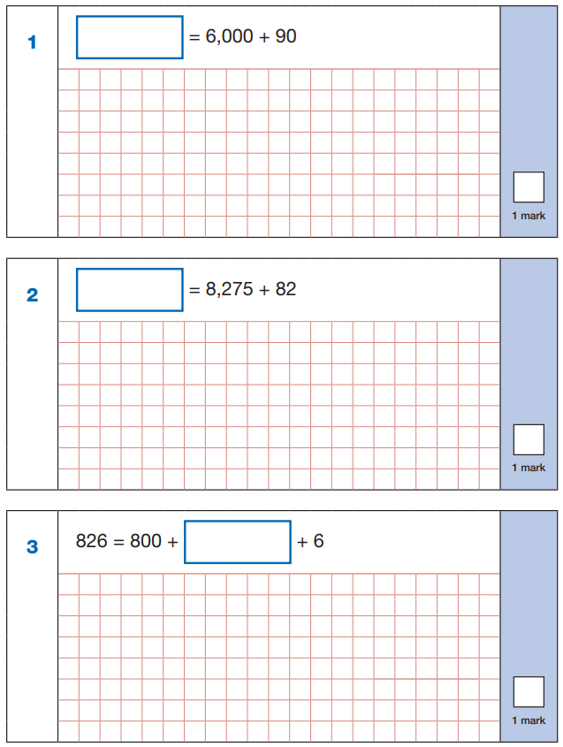
What do the tests look and feel like?
Maths - Arithmetic

Slide 6
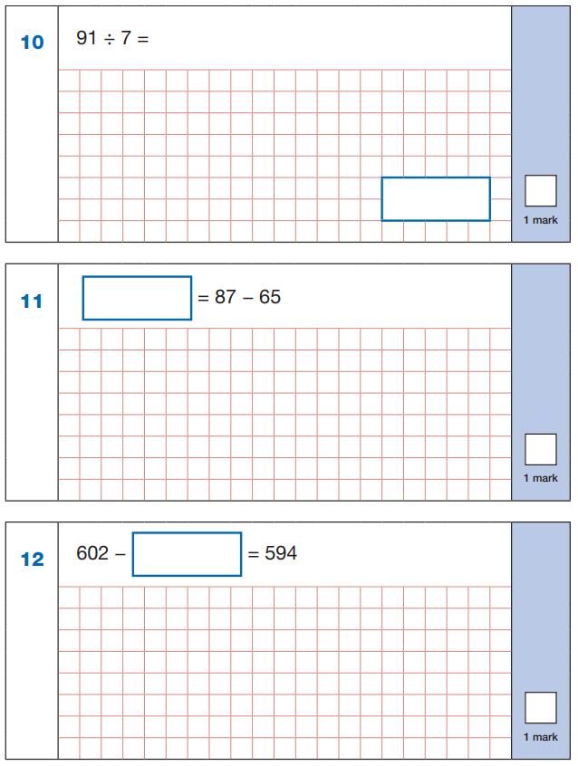
What do the tests look and feel like?
Maths - Arithmetic

Slide 7
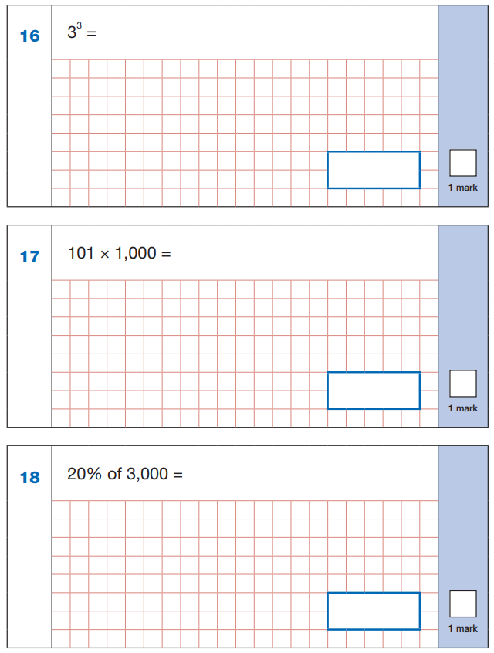
What do the tests look and feel like?
Maths - Arithmetic

Slide 8
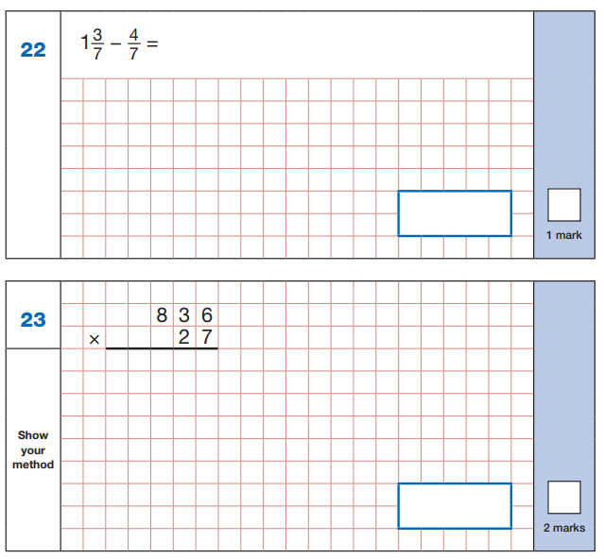
What do the tests look and feel like?
Maths - Arithmetic

Slide 9
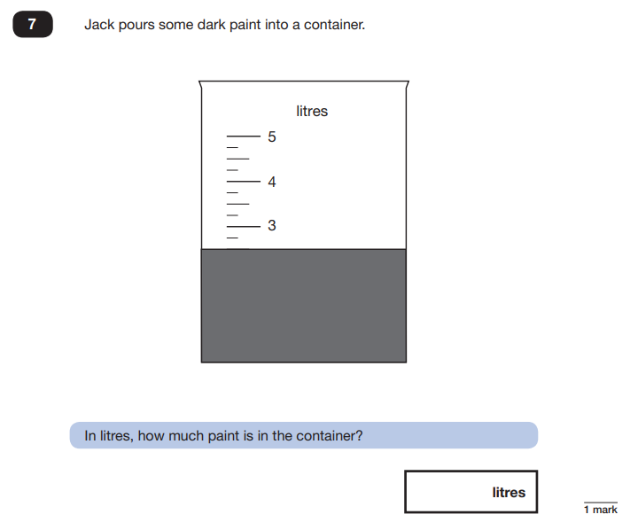
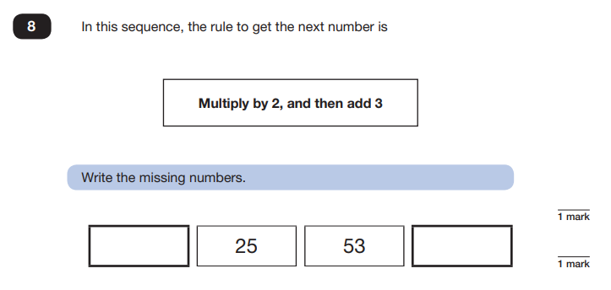
What do the tests look and feel like?
Maths - Reasoning

Slide 10
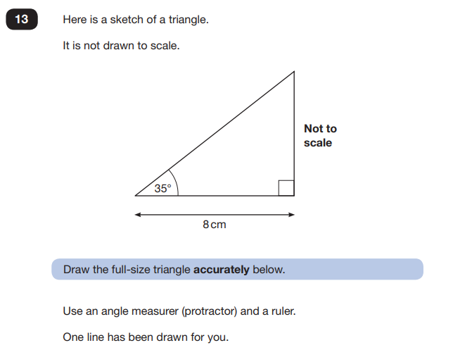
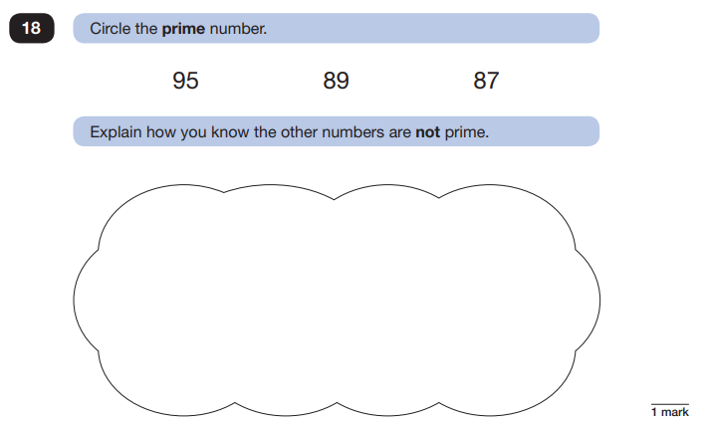
What do the tests look and feel like?
Maths - Reasoning

Slide 11
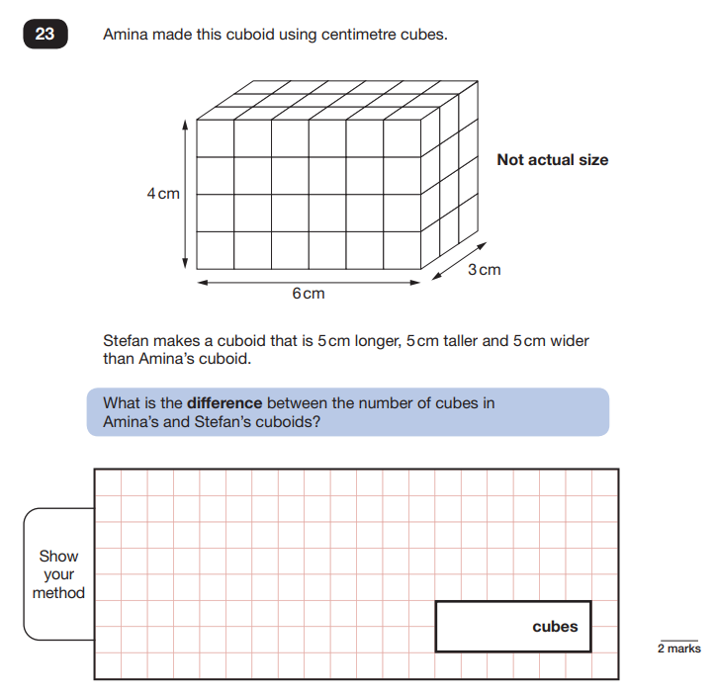
What do the tests look and feel like?
Maths - Reasoning

Slide 12
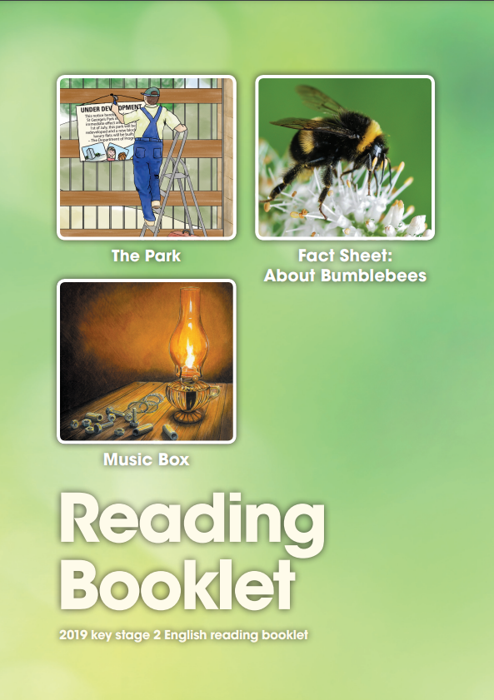
What do the tests look and feel like?
English - Reading

Slide 13
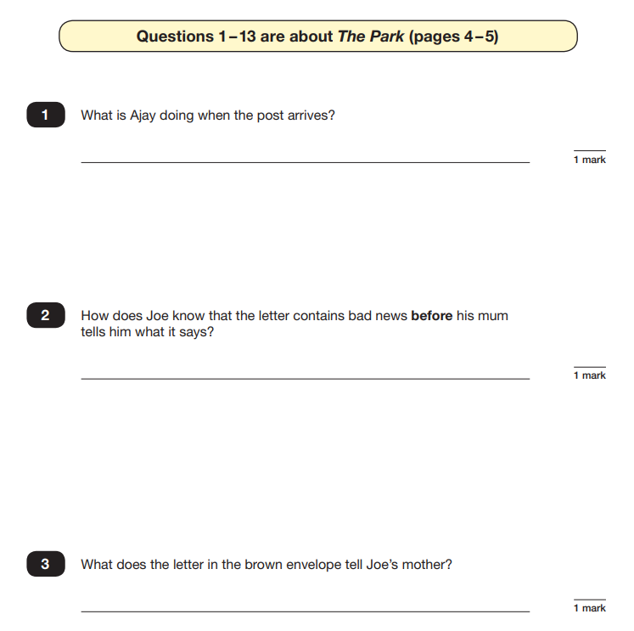
What do the tests look and feel like?
English - Reading

Slide 14
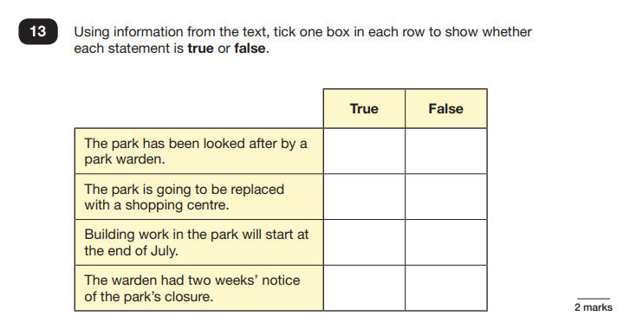
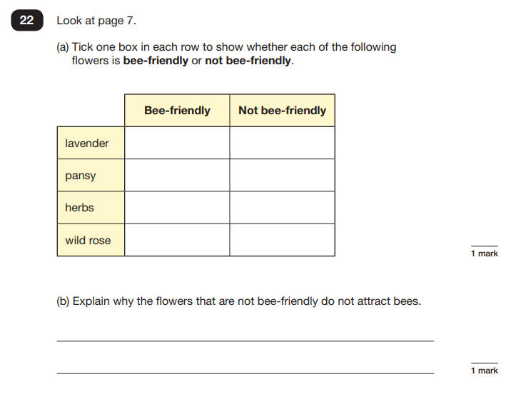
What do the tests look and feel like?
English - Reading

Slide 15
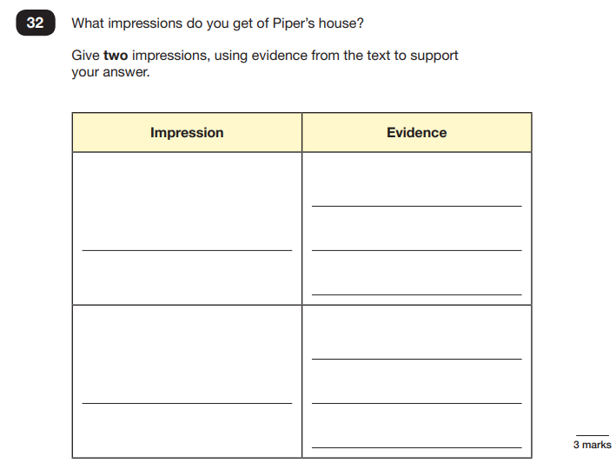
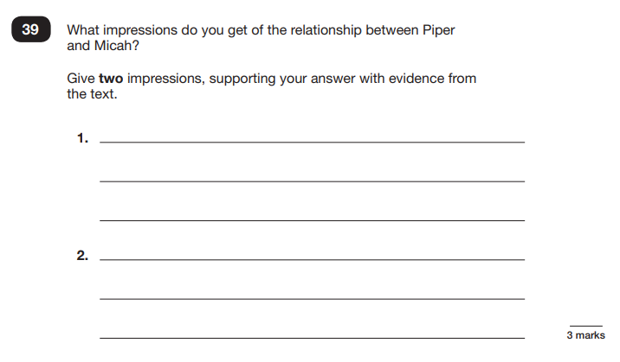
What do the tests look and feel like?
English - Reading

Slide 16
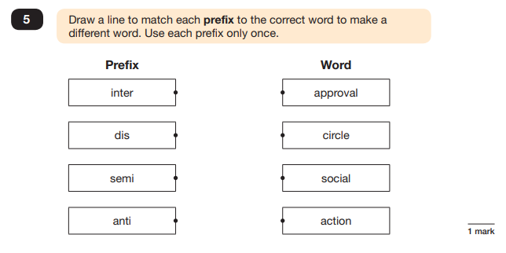
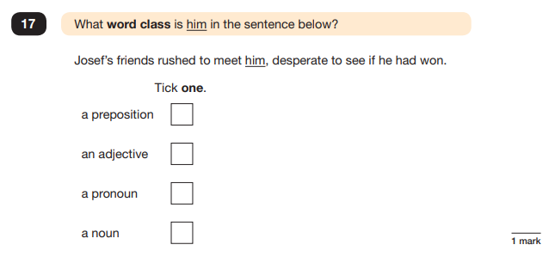
What do the tests look and feel like?
English – Grammar, Punctuation & Spelling

Slide 17
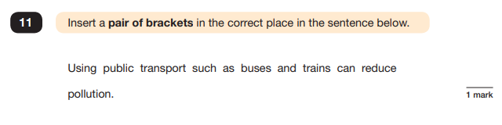
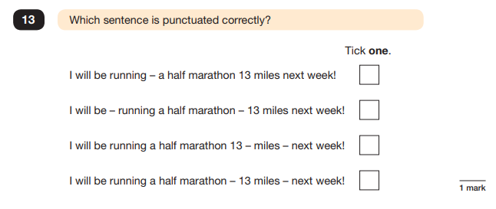
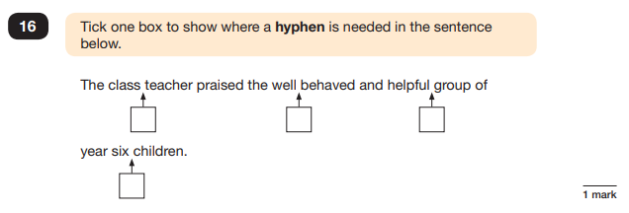
What do the tests look and feel like?
English – Grammar, Punctuation & Spelling

Slide 18
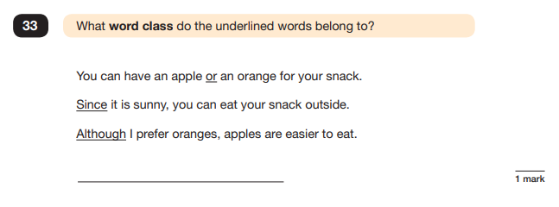
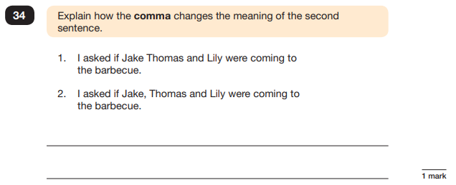
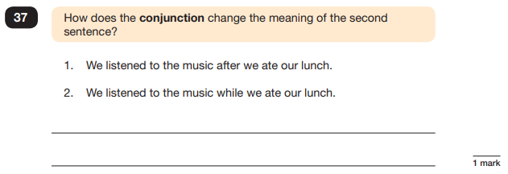
What do the tests look and feel like?
English – Grammar, Punctuation & Spelling

Slide 19
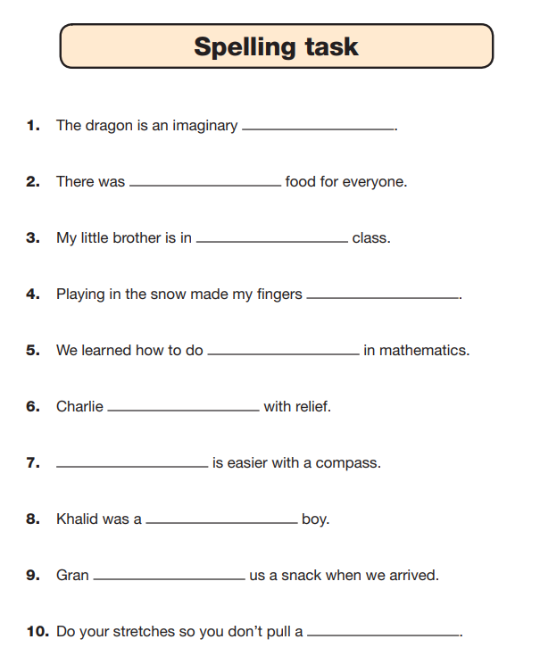
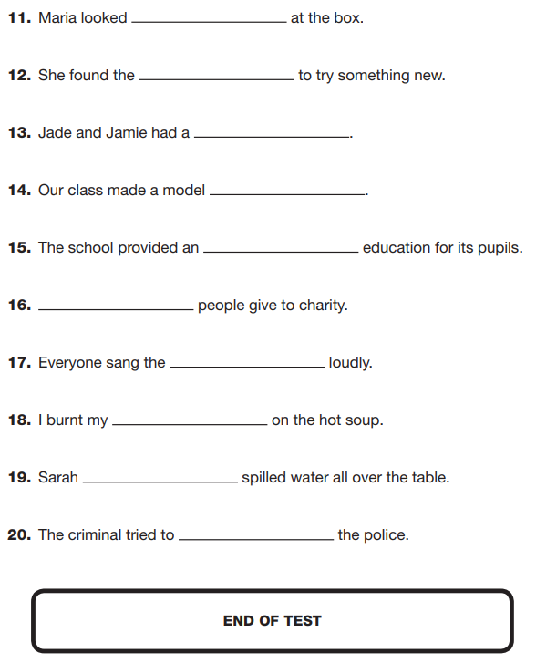
What do the tests look and feel like?
English – Grammar, Punctuation & Spelling

Slide 20
Information parents will receive
End of year report - July
Print out of information showing whether end of year expectation has been met or not in Maths, Reading and Grammar, Punctuation and Spelling.
Writing will be assessed through Teacher Assessments as well as Science and the foundation subjects.

Slide 21
How will the tests be administered?
The tests are administered in the most relaxed and familiar way possible
Children take the tests in the classroom or suitable rooms in school
Children are invited into school from 8.10am each day during the official week to have breakfast together to give them a calm start to the day and to allow any issues/questions to be addressed promptly by staff

Slide 22
How are we supporting your child?
Revision practice – children are already regularly exposed to similar practice questions in the classroom
Booster classes and Tutoring sessions are to target children who may need to receive extra sessions in Maths and/or Literacy in addition to their whole class lessons. Booster classes and tutoring sessions have started; some may be held before or after school. Parents are contacted individually re. these sessions.
We do frequent data analysis to allow us to keep up to date with exactly where the children are.
Supporting each other – lots of paired and group work to give each other feedback and learn from one another
Homework – increase in homework for Y6 children and using the CGP SATs busters books

Slide 23
How are we supporting your child?
We will prepare the children by running ‘mock’ assessment weeks, leading up to the actual week – our first one after Easter!
We will be using previous KS2 SATs papers and a range of other sample papers that have been carefully produced in line with the 2014 curriculum and End of KS2 expectations.

Slide 24
How can you support your child?
Through the daily homework activities (Mon-Thurs)
If you notice a particular area your child is struggling with please speak to their class teacher.
Below are some websites and activities that will support the children’s learning:
Times Table Rockstars (App or Website)
http://www.ixl.com
http://www.topmarks.co.uk/
http://www.crickweb.co.uk/ks2literacy.html
https://www.bbc.co.uk/schools/410.shtml
https://www.bbc.co.uk/bitesize
http://www.primaryhomeworkhelp.co.uk/
https://claritymaths.uk/games/index.html

Slide 25
Questions
If you have any questions, please speak to your child’s class teacher.

