Slide 1


Maths reasoning and problem solving
Aims:
To provide parents with detailed examples of how to solve maths problems
To equip parents with ways to support their child’s Maths learning at home.

Slide 2
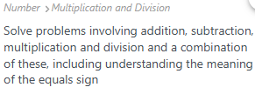

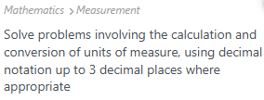

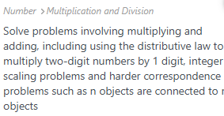


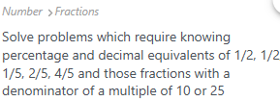
Maths reasoning and problem solving
Curriculum Coverage

Slide 3
Maths reasoning and problem solving
How do we teach this key area of learning?
At Walton Oak, Maths is taught through a number of different methods. These include:
In class learning
Active Maths - Tagtiv8
Practical activities and investigations
Abstract and pictorial representations - use of manipulatives
Fluency, Reasoning and Problem Solving

Slide 4
Maths reasoning and problem solving
A key area of learning that has been proven to develop a child’s understanding and critical thinking of number, and give them the required skills to be able to work through the process of problems in maths, is using reasoning and problem solving.
But why?
Understand the why and how, not just the do
Challenge thinking and problem solving skills
Build confidence when tackling trickier word problems
Extend greater depth knowledge

Slide 5
Maths reasoning and problem solving
What is reasoning?
Reasoning is the process through which people reason or come to conclusions. This involves studying the process humans use to solve problems and come to a decision.
Reasoning in maths is the ability to make logical links and connections which help you tackle a new maths problem. The skill of reasoning equips students not only with the ability to say how they will attempt to work out an answer, but why and how they can be sure it will work.
Reasoning in maths KS2
By the time children move onto reasoning in maths in KS2, they should have a more established idea of what reasoning is and how to apply what they know to new maths problems. By the time children find themselves in KS2, generally speaking, they should have quite a sound understanding of basic processes and links within maths. This will be built upon further as children prepare not only for the KS2 SATs, but also for the new challenges of secondary school.

Slide 6
Maths reasoning and problem solving
What is problem solving?
Math strategies for problem-solving help students use a range of approaches to solve many different types of problems. It involves identifying the problem and carrying out a plan of action to find the answer to mathematical problems. Problem-solving skills are essential to maths in the general classroom and real-life. They require logical reasoning and critical thinking skills. Students must be equipped with strategies to help them find solutions to problems.
In planning and executing a problem, problem solvers may need to:
select and use appropriate and efficient techniques and strategies to solve problems
identify what further information may be required in order to pursue a particular line of enquiry and give reasons for following or rejecting particular approaches
break down a complex calculation problem into simpler steps before attempting a solution and justify their choice of methods
make mental estimates of the answers to calculations
present answers to sensible levels of accuracy; understand how errors are compounded in certain calculations.

Slide 7
Maths reasoning and problem solving
Fluency is crucial in teaching a child a method that they need to use within maths; however, it does not provide any context to a question. A child may be able to complete a ‘do now’ task which requires them to use a certain method, but when this is put into a word problem that involves multiple steps, they can hit a wall.
Alfie went to a football game. In the stadium there were 56 stands which each sold 4826 hot dogs at a match. How many hot dogs were sold in total?
Each hot dog cost £2.55. How much did they make in total?
4826
x 56
Alfie says that to work out how many hot dogs were sold, he must do 4826 add 56. Is Alfie correct? Explain how you know?
270,256
X 2.55

Slide 8
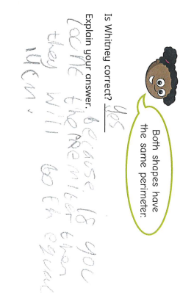
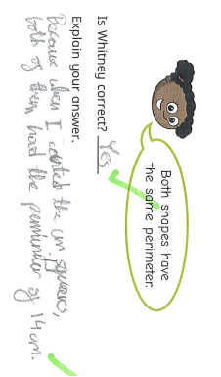
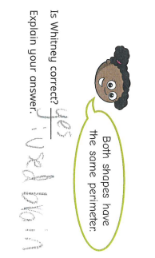
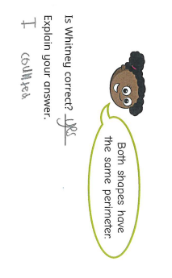
Maths reasoning and problem solving
Examples:

Slide 9
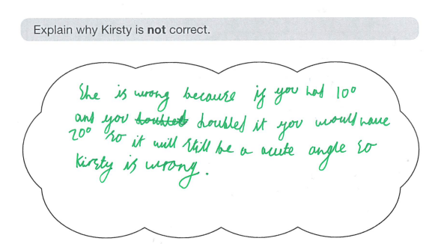
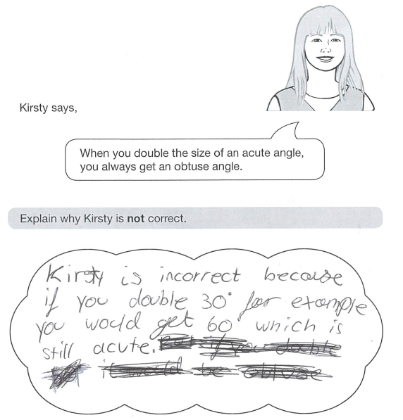
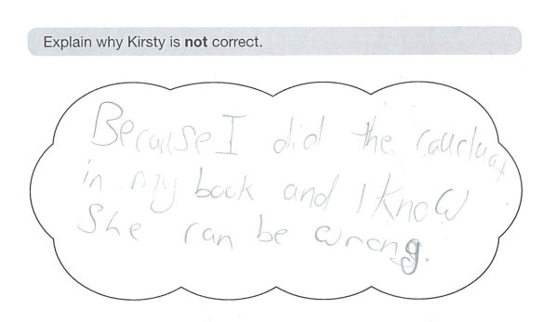
Maths reasoning and problem solving
Examples:

Slide 10
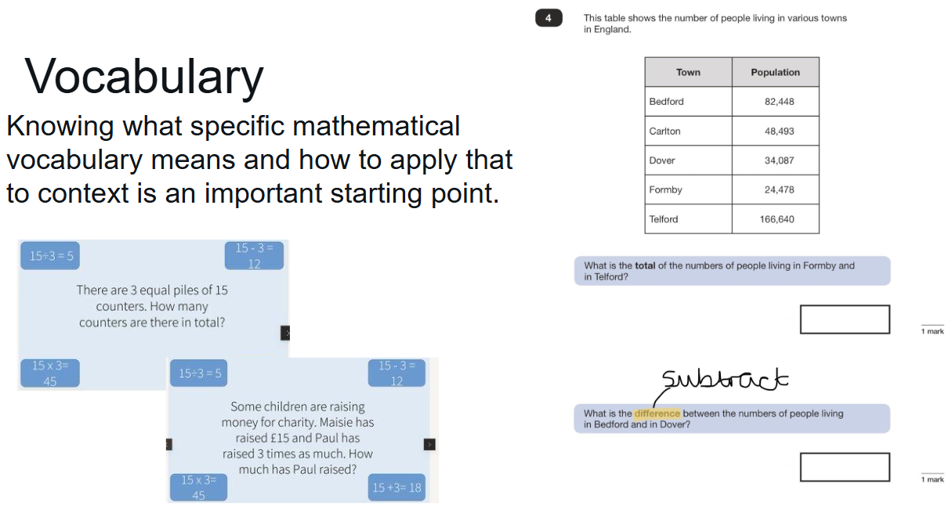
Maths reasoning and problem solving

Slide 11
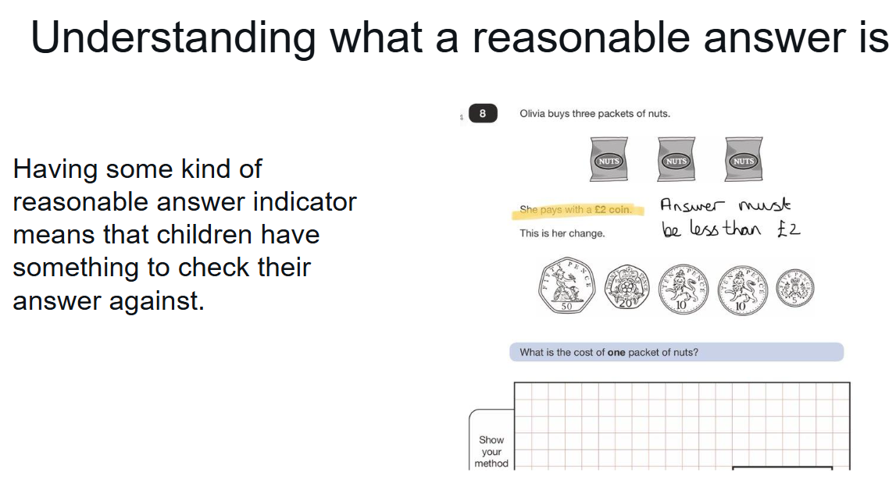
Maths reasoning and problem solving

Slide 12
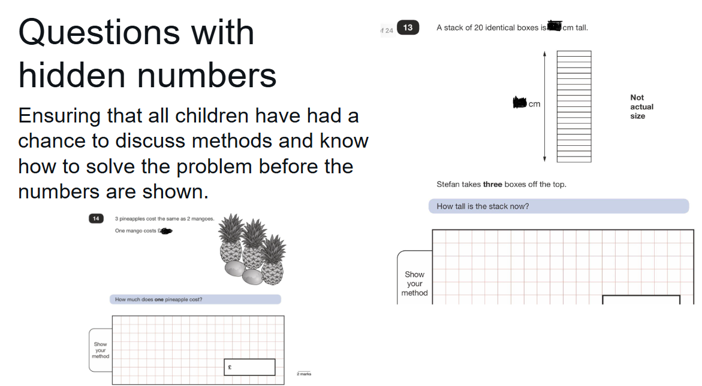
Maths reasoning and problem solving

Slide 13
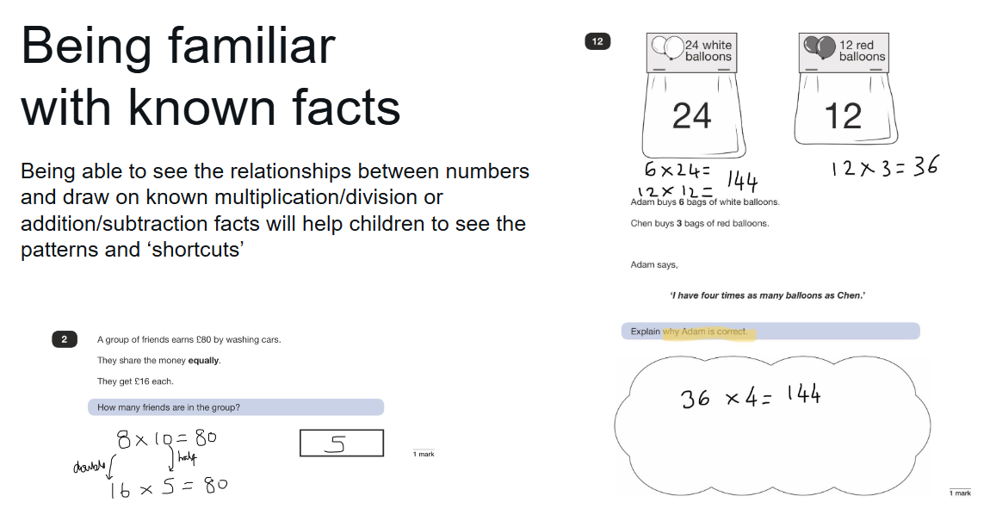
Maths reasoning and problem solving

Slide 14
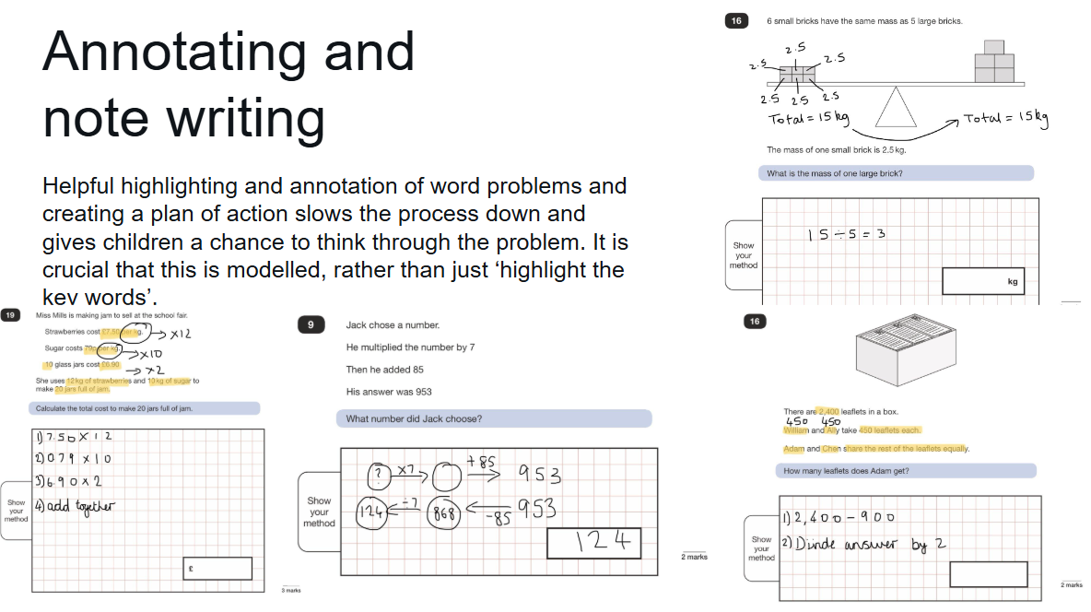
Maths reasoning and problem solving

Slide 15
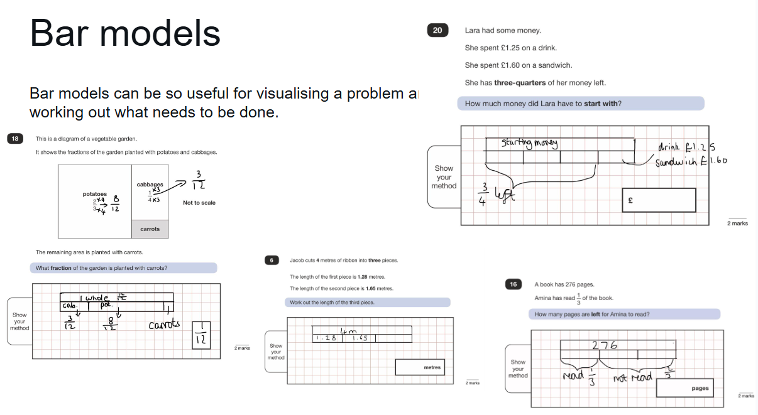
Maths reasoning and problem solving

Slide 16
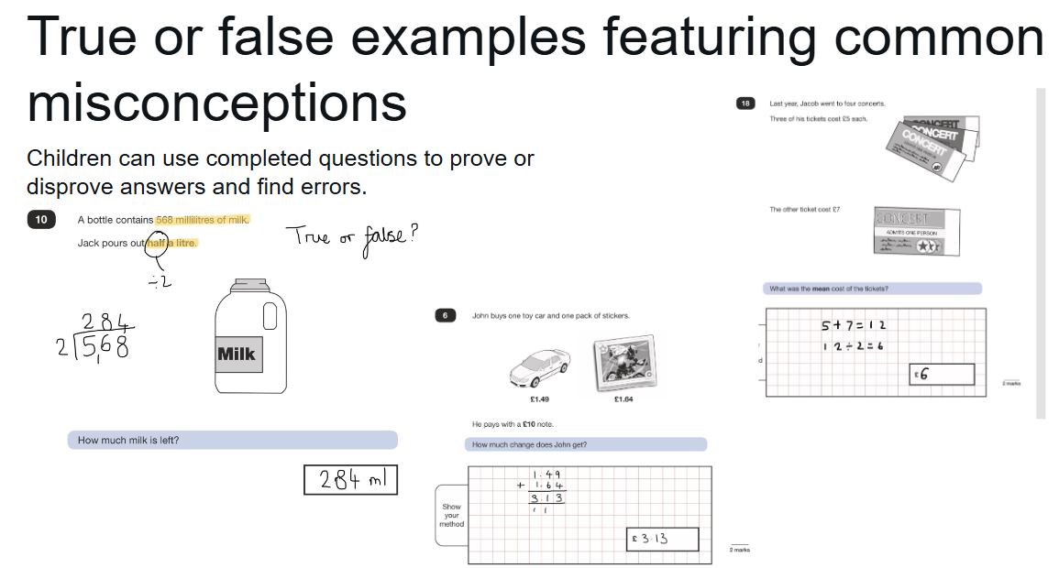
Maths reasoning and problem solving

Slide 17
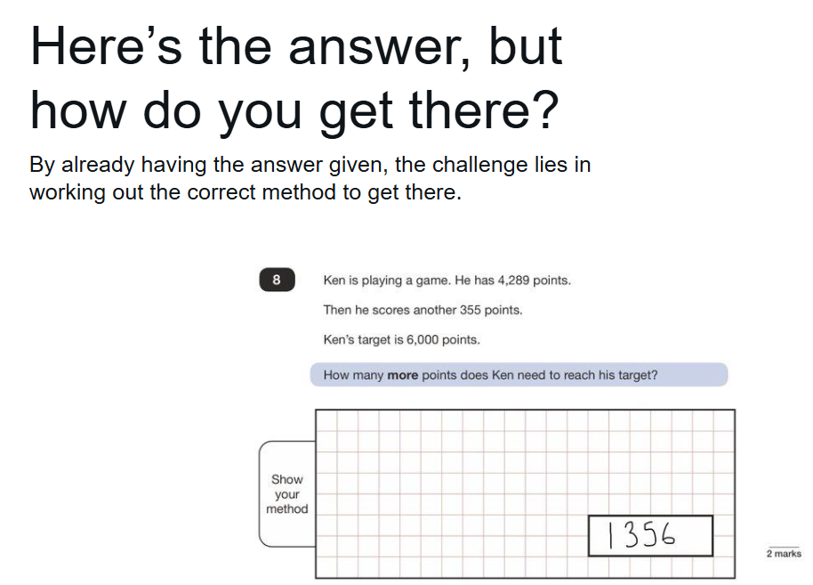
Maths reasoning and problem solving

Slide 18
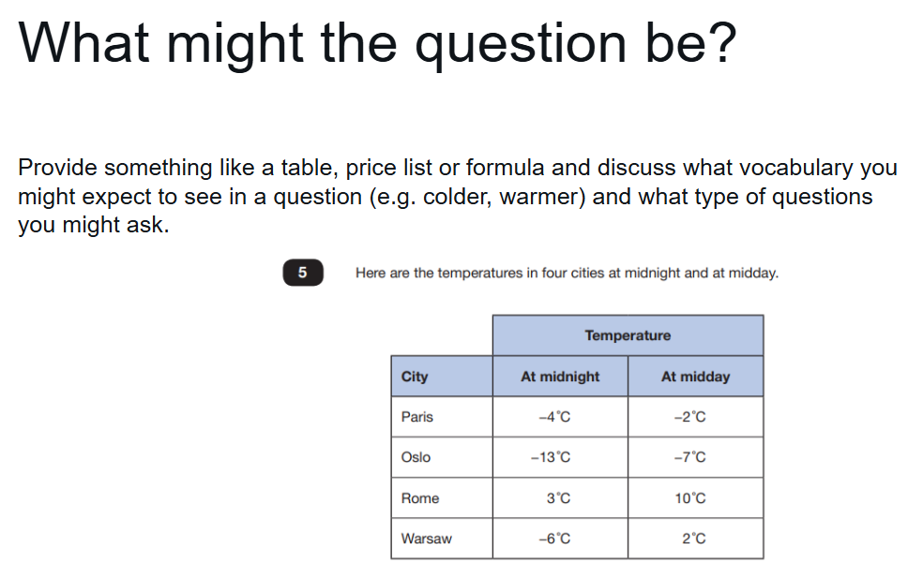
Maths reasoning and problem solving

Slide 19

Feedback
Please take a moment to share your feedback with us

