Slide 1

Writing Expectations
Year 2 & 3
Mrs. Butler & Miss Gobie
“You can always edit a bad page. You can’t edit a blank page.”
– Jodi Picoult

Slide 2

Writing Expectations
Our Aims for this evening:
To explain the importance of writing.
To outline the end of year expectations.
To explore how writing is taught at Walton Oak
To outline strategies that you can use to support your child with writing at home.

Slide 3
Writing Expectations
Our Aims for Writing at Walton Oak Primary:
Writing is a crucial life skill. Our intent is to provide children with the skills to write fluently and communicate their ideas and emotions to others effectively while also developing their love for writing across the whole curriculum.

Slide 4
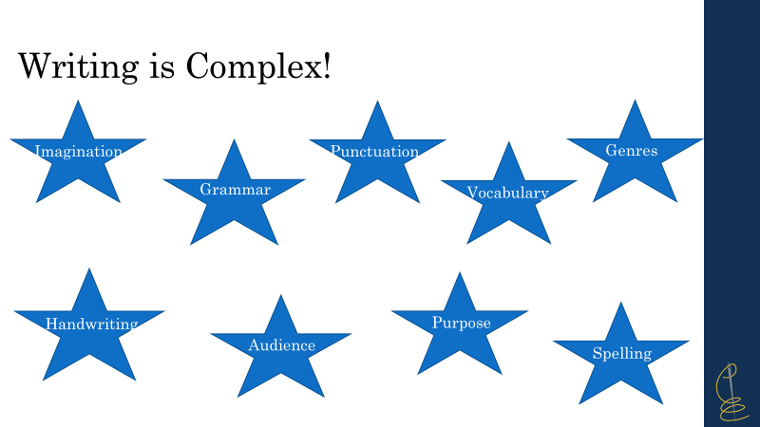
Writing Expectations

Slide 5

Writing Expectations
Curriculum Coverage
Year 2
Commas for list
Subordination, coordination
Expanded noun phrases
Apostrophes for contractions and possession
Sentence types: statement, question, exclamation, command
Compound words
Suffixes- ness –er, -ful, -less –est, -ly
Present/past, progressive form of verbs
Notes:
Handwriting

Slide 6
Writing Expectations
Expected standard for the end of year 2
Write simple, coherent narratives about personal experiences and those of others (real or fictional)
Write about real events, recording these simply and clearly.
Demarcate most sentences in their writing with capital letters and full stops, and
use question marks correctly,
Use present and past tense mostly correctly and consistently.
Use co-ordination (e.g. or / and / but) and some subordination (e.g. when / if / that / because) to join clauses.
Segment spoken words into phonemes and represent these by graphemes, spelling many of these words correctly and making phonically-plausible attempts at others
Spell many common exception words
Form capital letters and digits of the correct size, orientation and relationship to one another and to lower-case letters.
Use spacing between words that reflects the size of the letters.
Notes:
Handwriting

Slide 7
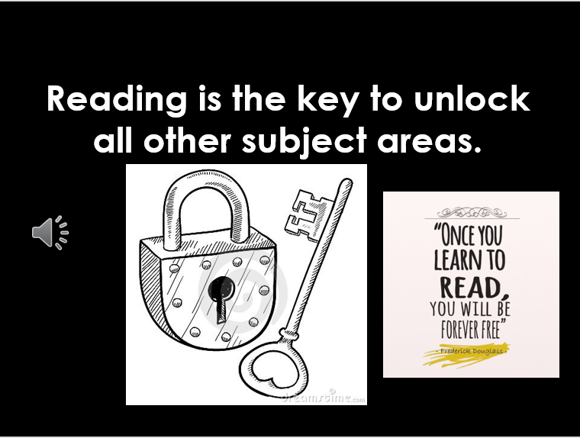
Writing Expectations
Notes:
Vocabulary and language, story ideas

Slide 8


Writing Expectations
Spelling
shell
chef
special
caption
mansion
passion
Notes:
Cognitive load

Slide 9
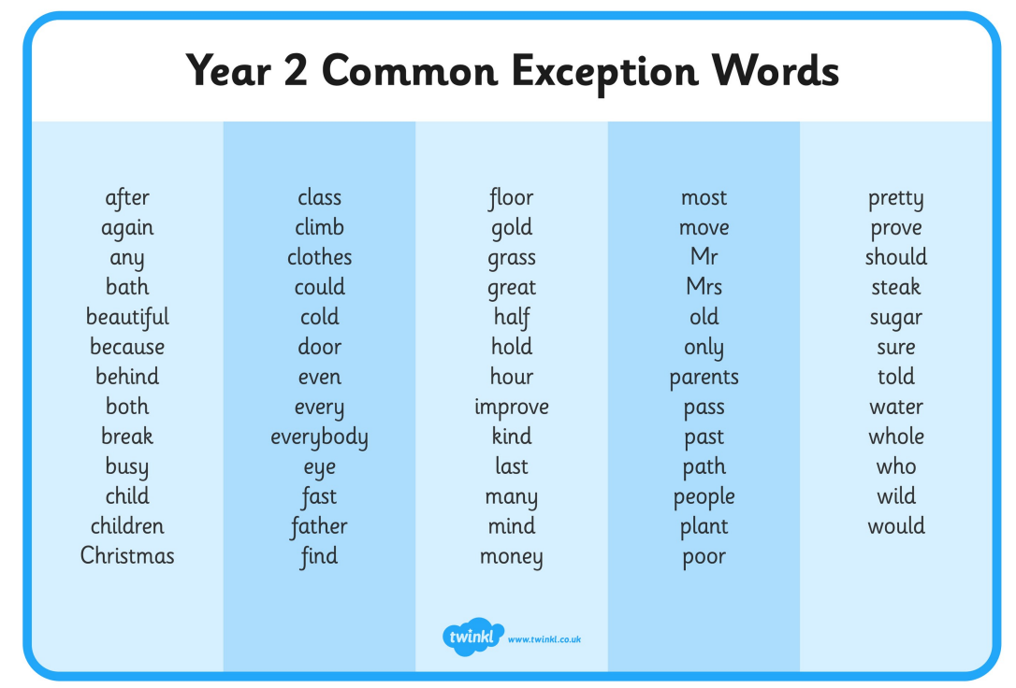
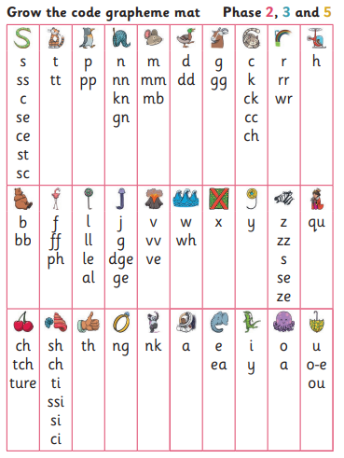
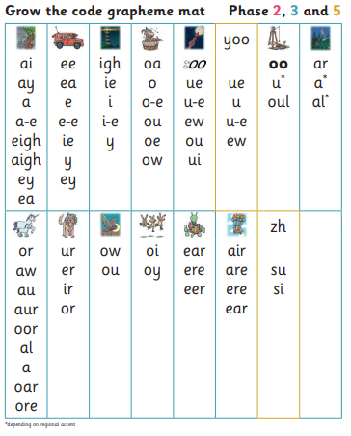
Writing Expectations

Slide 10
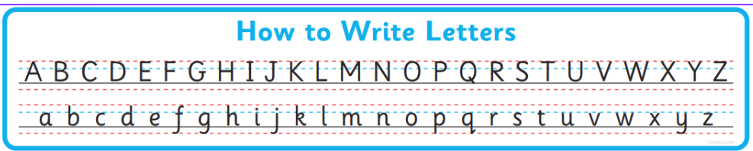
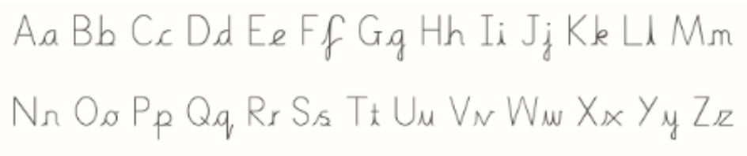
Writing Expectations
Handwriting and letter formation

Slide 11
Writing Expectations
Word classes
Noun-
Verb-
Adjective-
Adverb-
A person, place or thing
A doing word
A describing word (describes the noun)
Describes how the “doing” was done.
Jack tiptoed nervously through the narrow hallway.
The cute baby giggled loudly as the dog wagged its fluffy tail.
Notes:
Suffixes are letters that can be added to the end of words to change their meaning. Adding the suffix -ly, turns an adjective into an adverb. If the word ends with 'y', the 'y' becomes an 'i', and then add -ly. If the word ends with 'le', drop the 'le' and add -ly.
Loud - loudly,

Slide 12
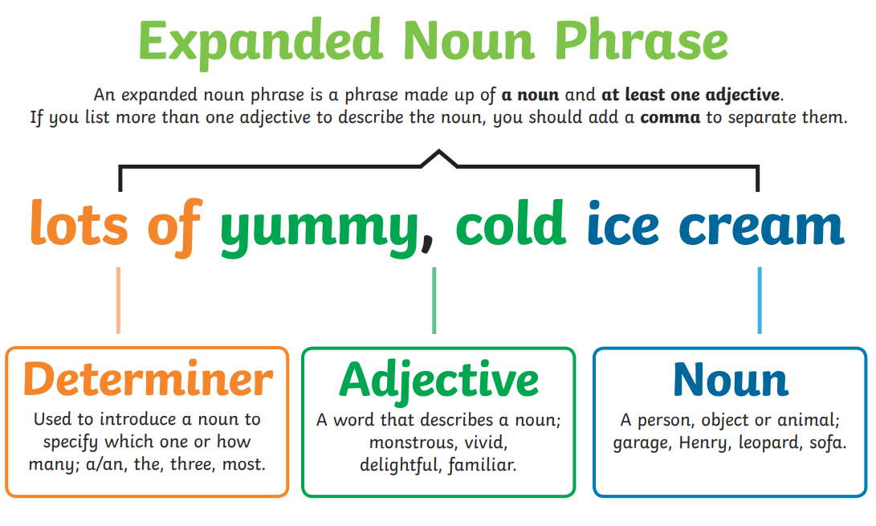
Writing Expectations

Slide 13

Writing Expectations
Punctuation
Full stops- to show the end of a sentence/statement.
Capital Letter – beginning of sentences, names, places
Tim is best friends with Sam.
Kate lives in London.
Question marks- when a question is asked.
Can you help please?
Do you have a spare pen?
Exclamation marks
How beautiful the sky is!
What an exciting journey that was!

Slide 14
Writing Expectations
Sentence Types
Exclamatory – begins with a what or a how, contains a verb and a noun, end with !
What an exciting adventure that was!
How handsome the prince looks!
Commands – bossy sentences, imperative verbs
Don’t eat the sweets!
Cut the shape out.
Questions – Asks something, ends in a question mark
Can I come too?
What colour is the sky?
Statement – gives information, ends in a full stop
The bird has grey feathers.
Jack and Jill fell down the hill.

Slide 15
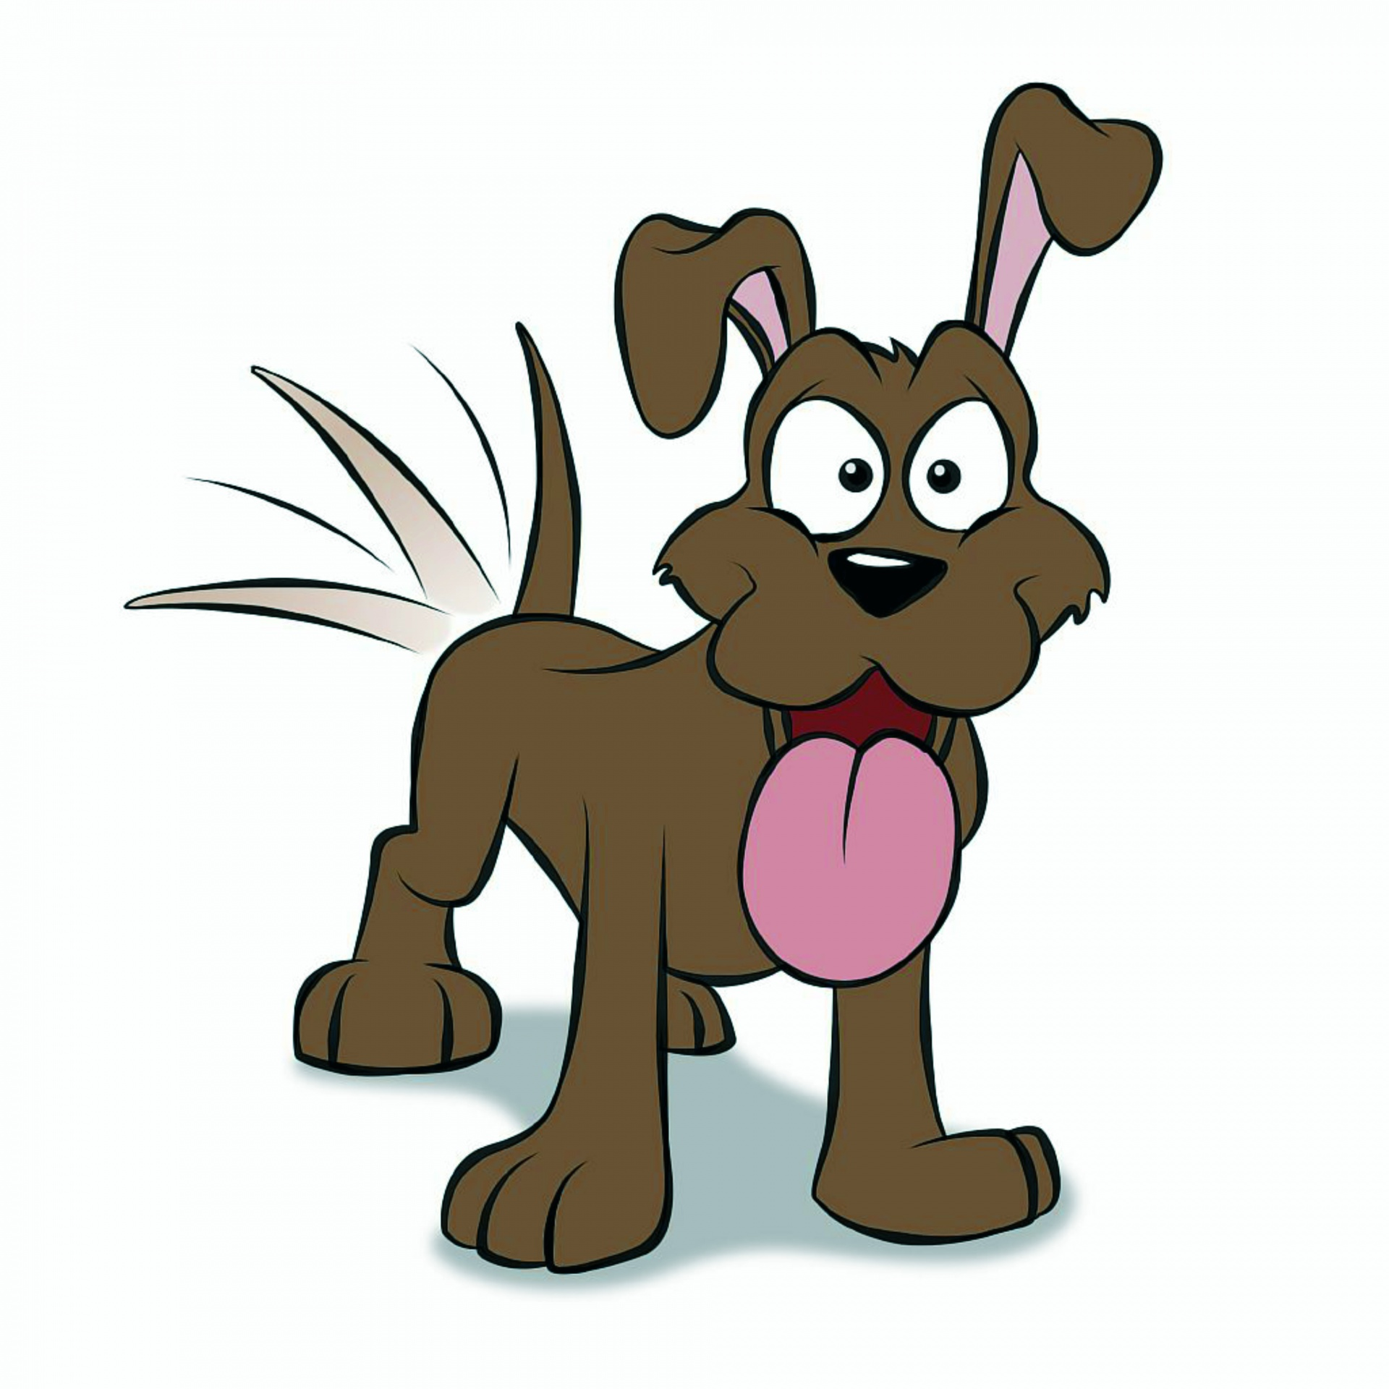
Writing Expectations
Punctuation
Apostrophes for possession and contractions
Dad’s socks are smelly.
I sat on my sister’s chair.
The dogs’ tails were fluffy.
I will- I’ll
Would not- wouldn’t
Commas- to separate items in a list.
I enjoy reading, singing and cycling.
The tiny, fluffy dog sniffed the flowers.

Slide 16

Writing Expectations
Coordinating and subordinating conjunctions
Coordinating conjunctions join two or more items of equal importance AND ARE OFTEN IN THE MIDDLE:
And : The children play tennis and they go to the park.
But: They can climb but they can’t swim.
Or: You can have mashed potato or you can have chips .
So: They got the highest score so they won the match.
Subordinating connectives (often introducing a subordinate clause that usually only makes sense next to the main clause)
When: We put our coats on when it rains.
If: I’ll help you if you like.
Because: I’m sad because it hurt.
That: I’d like a cake that has sparkles.

Slide 17
Writing Expectations
Tenses
Present | Past | Past progressive | Present progressive
He jumps. | We jumped. | They were jumping. | He is jumping.
I sleep. | They slept. | She was sleeping. | He is sleeping.
She paints. | You painted. | I was painting. | They are painting.

Slide 18
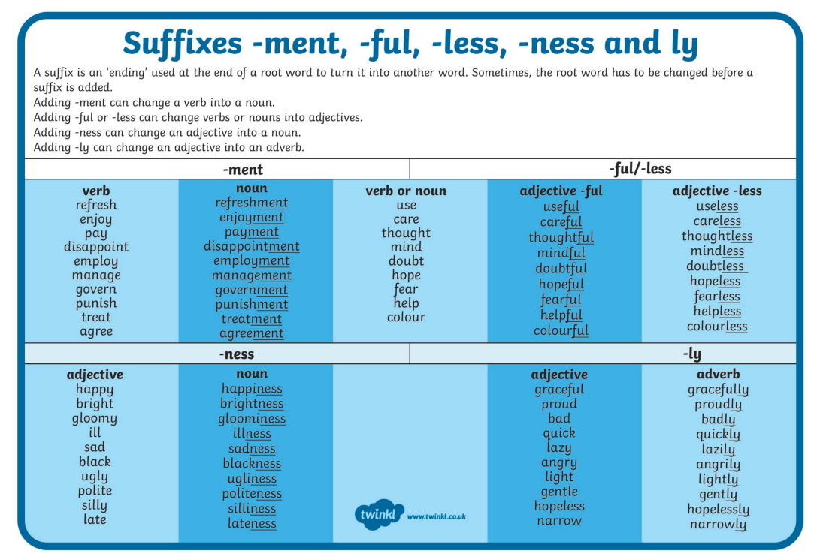
Writing Expectations

Slide 19
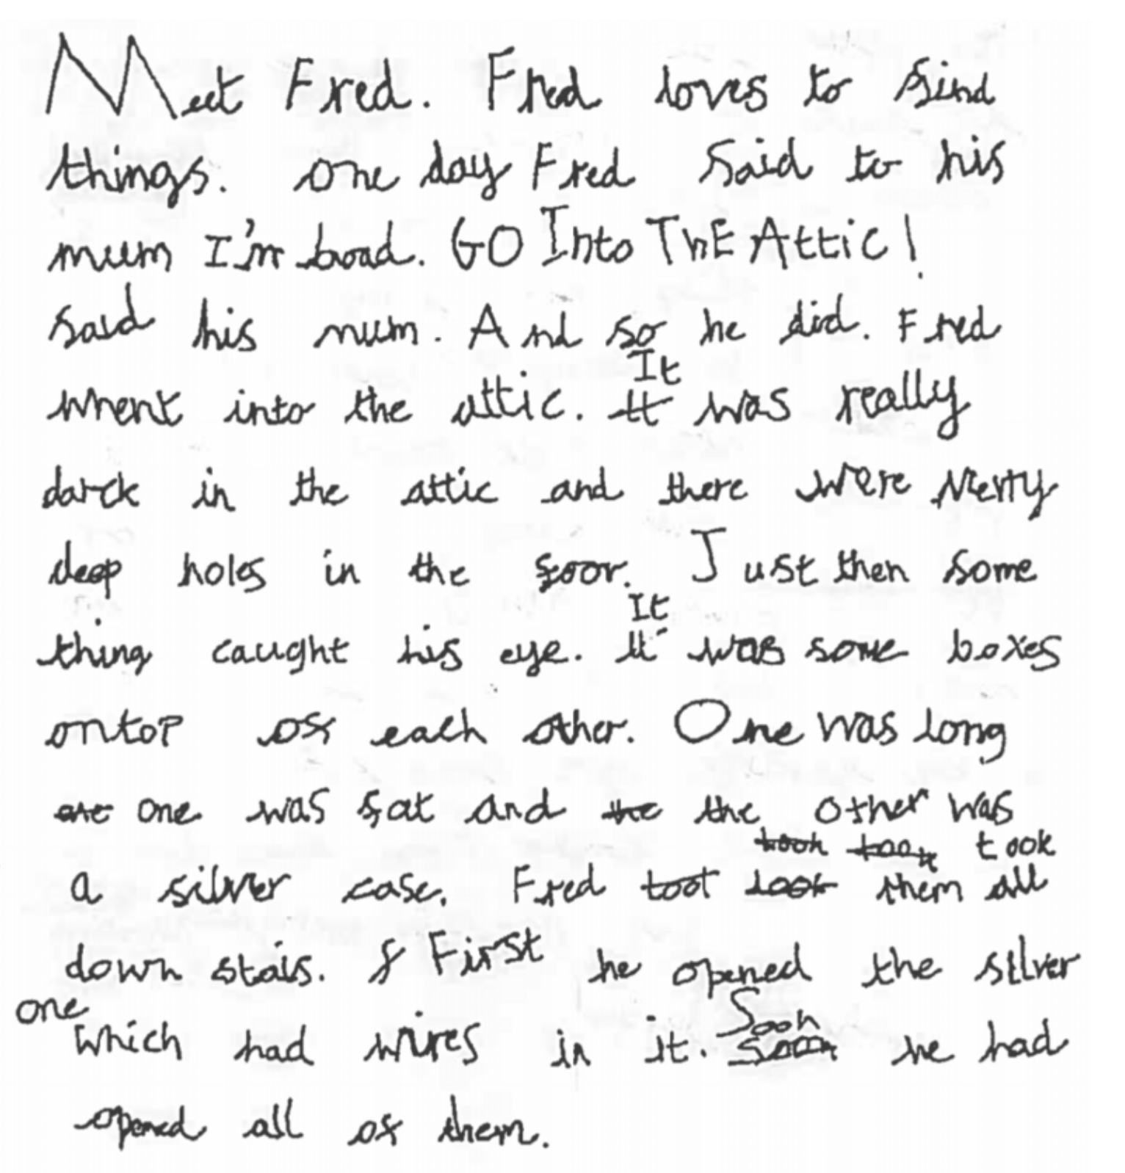
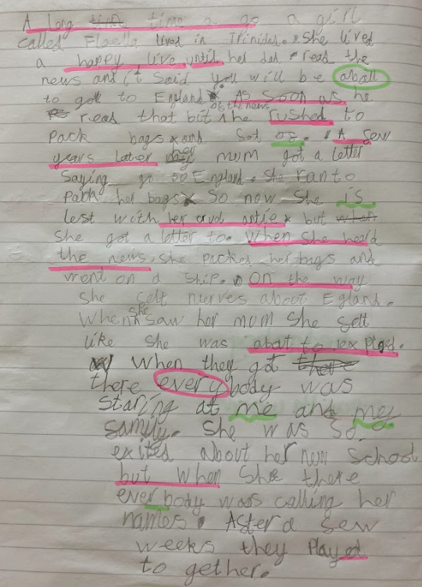
What does writing look like in Year 2
Notes:
This is Mid Expected because ….
Use of full stops and capital letters.
Apostrophe for contraction in I’m.
Use of ‘es’ ending in boxes.
Use of and’ to join sentences.
Accurate spacing and handwriting.
Sentences are recorded simply and clearly.
And used as a conjunction.

Slide 20
Writing Expectations
Curriculum Coverage
Year 3
Effective composition involves forming, articulating and communicating ideas, and then organising them coherently for a reader.
This requires clarity, awareness of the audience, purpose and context, and an increasingly wide knowledge of vocabulary and grammar.
Writing down ideas fluently depends on effective transcription.
Spelling quickly and accurately.
Writing also depends on fluent, legible and, eventually, speedy handwriting.

Slide 21
Writing Expectations
Expected standard for the end of year 3
Use a wider range of prefixes and suffixes - un, dis, mis, re, pre
Write for a range of purposes and audiences and develop an awareness of language and form (writing for different purposes)
Create settings, characters and plot
Use speech punctuation
Use adverbs - often, quickly, very.
Use prepositions - next to, underneath, with
Use past and present tense - ran, wander and begin to use other verb forms - will go, have eaten.
Increase the legibility, consistency and quality of handwriting - diagonal and horizontal strokes.
Spell words from the year 3 and 4 spelling list
Evaluate and edit writing
Use coordinating conjunctions and subordinating conjunctions - and, because, when, even, though
Use apostrophes for possession and commas in lists correctly.

Slide 22
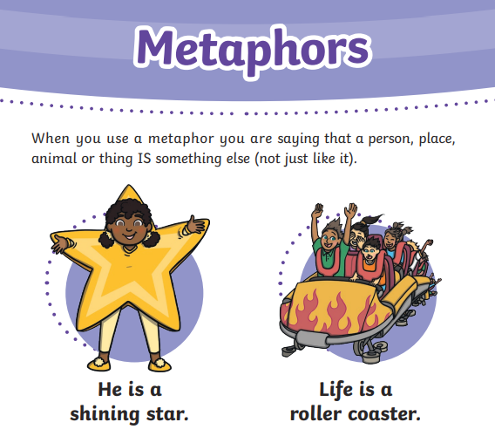
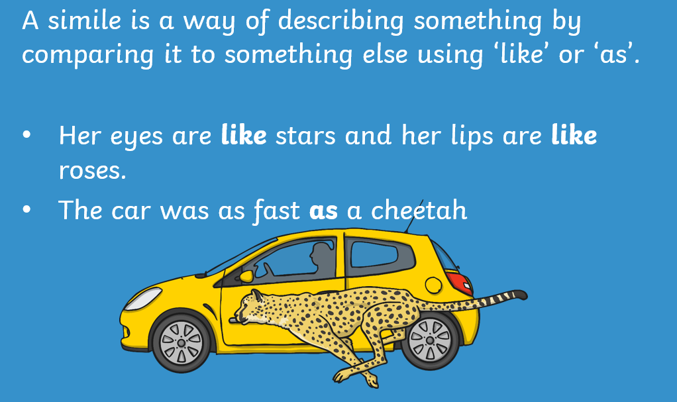
Writing Expectations
Similes and Metaphors

Slide 23
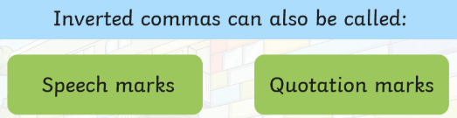
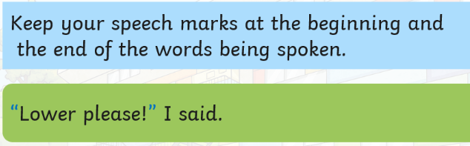
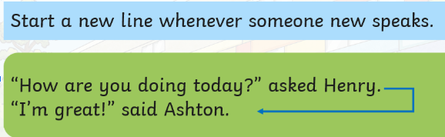
Writing Expectations
Speech Marks

Slide 24
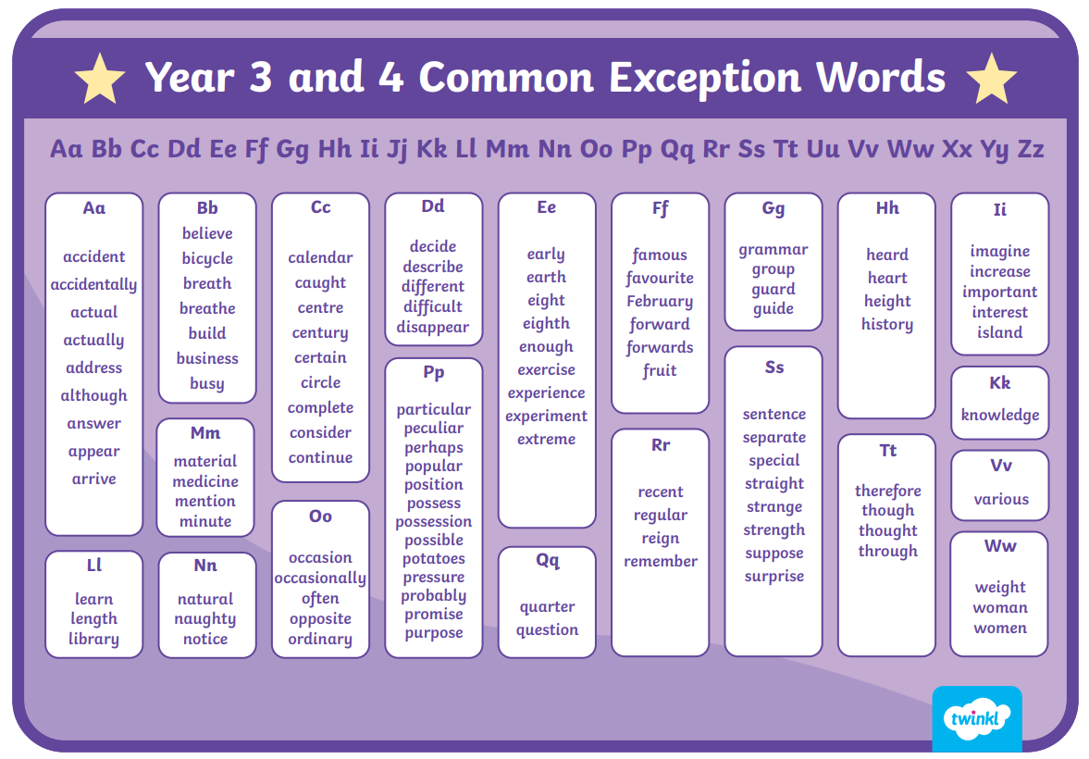
Writing Expectations

Slide 25
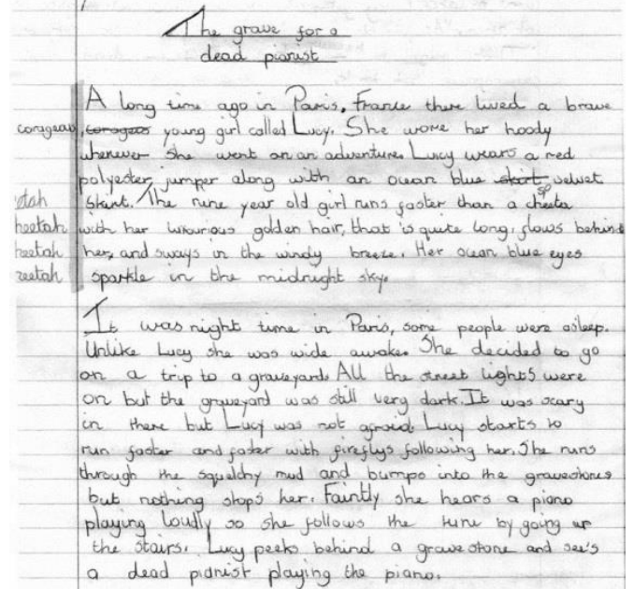
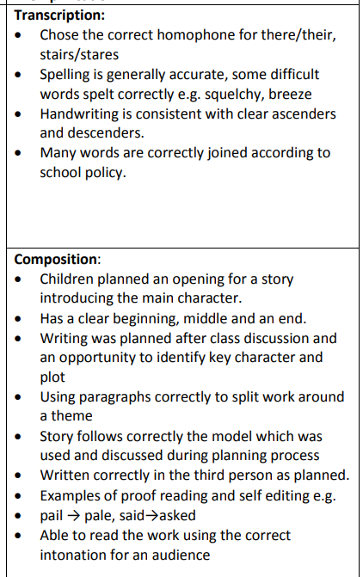
Writing Expectations

Slide 26
Writing Expectations
How do we teach writing?
Imitation: We spend time learning a familiar text to internalise language and identify the structure of the writing - this is our Power of Reading Text!
Innovation: We will change the familiar text using shared ideas followed by planning and writing it together to create a purposeful piece of writing
Independent Application: The children use their own ideas to plan and write independently

Slide 27

Walton Oak Writing Journey Key Stage 1
Introduction of first skill
(grammar and punctuation)
Short piece of writing linked to POR text.
Steps to Success clear and modelled.
Introduction of second skill
Language focus - using and applying.
Talk for writing / Oracy skills
Writing opportunity linked to POR text - group writing/ questions to characters, hot seating.
Steps to Success clear and modelled.
Hook/Stimulus
Introduction of Learning Journey
LO’s for the unit (to include key skills)
Vocabulary and connections developed.
Draw out key features of texts and model
Consolidation of language / grammar skills
Character /short extract / point of view.
Steps to Success clear and modelled.
Throughout week
Spellings addressed through marking and opportunities given to improve.
Working wall to have ‘real time’ modelled writes/ vocabulary on.
Oracy opportunities
Development of vocabulary
Remember
Sentence stems
Word mats
Modelling in ALL lessons
Address misconceptions and plan this in to input.
Live feedback - mark in the moment
Short plan and write
Plan modelled and key features highlighted.

Slide 28
Walton Oak Writing Journey Key Stage 2
Draw out key features of texts and model
Introduction of grammar and punctuation
Short piece of writing linked to POR text.
Steps to Success clear and modelled.
Hook/Stimulus
Introduction of Learning Journey
LO’s for the unit (to include key skills)
Boxing criteria to begin with key vocabulary (leave blank page)
Vocabulary and connections developed.
Introduction of Language focus - using and applying.
Talk for writing / Oracy skills developed.
Writing opportunity linked to POR text - group writing/ questions to characters, hot seating.
Planning for first draft and begin writing.
Plan modelled write and key features highlighted.
Finish extended writing
Throughout week
Spellings addressed through marking and opportunities given to improve.
Working wall to have ‘real time’ modelled writes/ vocabulary on.
Oracy opportunities
Development of vocabulary
Remember
Sentence stems
Word mats
Modelling in ALL lessons
Address misconceptions and plan this into input.
Edit and improve
Rewrite particular areas to uplevel.
Model example given based on learning.

Slide 29
Writing Expectations
Writing for different purposes
Letters
Diary Entry
Newspaper Articles
Non-chronological Reports
Poems
Stories
Descriptions
Vocabulary games

Slide 30

Writing Expectations
How is writing taught in Year 2 & Year 3?
Inviting authors, poets, illustrators into school
Modelling
Little Wandle Phonics /Bridge to Spelling.
Quality over Quantity
Exciting
Interventions
Oral Rehearsal
Purposeful
Cross-Curricular – through topic
Handwriting – daily

Slide 31
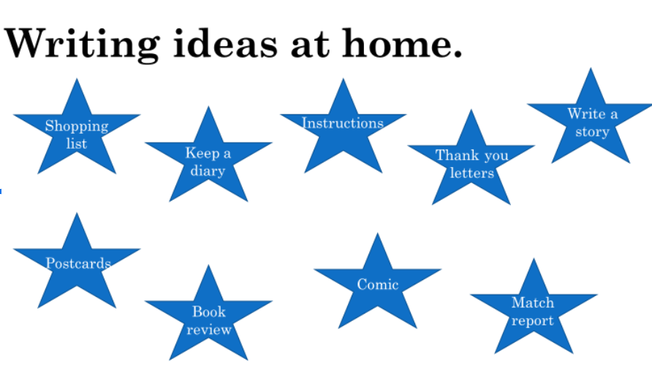
Writing Expectations
Notes:
ICT Games

Slide 32


Slide 33

Feedback
Please take a moment to share your feedback with us

