Slide 1

KS2 Grammar and Writing: Years 4, 5 & 6
Miss Pollard & Miss Green

Slide 2

Our Aims for Writing at Walton Oak Primary:
Writing is a crucial life skill. At Walton Oak, we aim to equip children with the skills to write fluently, accurately, and confidently, enabling them to communicate their ideas and emotions effectively. Through engaging and purposeful writing opportunities across the curriculum, we strive to foster a love for writing while preparing children for the demands of secondary school. We ensure they develop a strong grasp of grammatical terms and structures so they can write with precision, coherence, and creativity in a range of contexts.

Slide 3
Our Aims for this evening:
This session will provide a clear understanding of writing expectations across Key Stage 2. We will:
Give an overview of how writing is taught at Walton Oak
Give a brief overview of what children’s writing should look like by the end of Key Stage 1 and Year 3.
Discuss the writing expectations for each year group in Years 4, 5, and 6, outlining key skills and progression.
Understand the End of Key Stage 2 Assessments in relation to Grammar
Explore some of the key grammar features that children should be using
Discuss how you can support your child’s writing at home

Slide 4

How Writing is taught at Walton Oak
At Walton Oak, we follow a structured and engaging writing approach that ensures children develop their skills progressively while fostering a love for writing. Our teaching is inspired by Power of Reading texts, with each half-term’s writing cycle linked to a high-quality book.
2. Teaching a Grammar Focus
Before children begin writing, we explicitly teach a specific grammar skill that will be applied in their piece.
This could be sentence structure, punctuation, or a particular stylistic feature that particularly fits with the piece they are writing (e.g., using fronted adverbials in a diary entry).
This ensures that grammar is not taught in isolation but is embedded within meaningful writing.
1. Starting with a Hook
Each writing unit begins with an engaging hook to immerse children in the text and spark their creativity. This could be:
Reading the next chapter.
Exploring a key character or setting.
Analysing an image or illustration from the book.
This hook encourages discussion, deep thinking, and excitement about the upcoming writing task.
3. Planning the Writing
Depending on the type of writing (narrative, persuasive, explanation, etc.), children spend 1-2 lessons planning.
Planning focuses on:
Generating rich vocabulary relevant to the piece.
Structuring their ideas (beginning, middle, end).
Preparing for the grammar focus so they can apply it effectively.
5. Editing & Improving Writing
Once the piece is complete, children edit and improve their writing to a standard appropriate for their year group.
This includes:
Checking spellings and punctuation for accuracy.
Ensuring cohesion—sentences and paragraphs must flow logically.
Enhancing their vocabulary choices where needed.
This process helps children develop independence in refining their work, ensuring they meet year-group expectations while taking pride in their writing.
4. Writing the Extended Piece
Children then use their planning to write an extended piece, drawing on their ideas and vocabulary.
To support them, we provide:
Word banks to aid vocabulary choices.
Scaffolding where needed (e.g., sentence starters, writing frames).
Modelled writing from the teacher to demonstrate expectations and techniques.

Slide 5
How Writing is taught at Walton Oak
At Walton Oak, we expose children to a variety of writing styles to ensure they develop a broad skill set and can adapt their writing for different purposes and audiences. For example:
Descriptive Writing (Building Atmosphere)
Examples:
Setting descriptions (e.g., describing a stormy night, a bustling market, or an eerie forest).
Character descriptions (e.g., introducing a mysterious new character).
Narrative Writing (Creative & Storytelling) Examples:
Writing a diary entry in the role of a character (e.g., a day in the life of a character from the book).
Rewriting the narrative from a different point of view (e.g., a villain’s perspective).
Creating a new chapter that fits within the original story.
Writing an alternative ending to the story.
Persuasive Writing (Convincing the Reader)
Examples:
Writing a letter to persuade a character to change their actions.
Creating a speech (e.g., persuading a town to take action on an issue).
Writing an advert or review.
Poetry (Creative & Expressive Writing)
Examples:
Writing a free verse poem to express emotions.
Creating a rhyming poem inspired by a book or topic.
Writing a shape poem or acrostic poem.
Informative & Explanation Writing (Factual & Objective)
Examples:
Writing a non-chronological report (e.g., about a historical figure or a scientific topic).
Explaining how something works (e.g., the water cycle, how a castle was built).
Writing a biography of an important person.
Spelling and handwriting are taught separately to ensure children develop accuracy and fluency in both. Spelling lessons focus on rules, patterns, and word meanings, while handwriting lessons help children develop legible, joined, and consistent writing.
Instructional Writing (Clear, Step-by-Step Guides)
Examples:
Writing a set of instructions (e.g., how to survive in a rainforest, how to build an Anderson shelter).
Creating a recipe or a guide for a younger audience.

Slide 6
KS1 and Year 3 Writing
By the end of Key Stage 1 (Year 2), children should:
Write sentences that make sense and are correctly punctuated.
Use capital letters and full stops consistently, and begin using question marks and exclamation marks.
Use simple conjunctions (and, but, because) to join ideas.
Start using expanded noun phrases (e.g., the big, red balloon).
Use apostrophes for contractions (e.g., can’t, don’t).
Use commas in lists.
Begin to use inverted commas for speech (e.g., “Hello,” said Tom).
Form letters correctly and begin joining handwriting.
They should be familiar with the following grammatical terms: Noun, verb, adjective, adverb, conjunction, sentence, statement, question, exclamation, command.
By the end of Year 3, children should:
Write in paragraphs, grouping related ideas together.
Use a wider range of conjunctions (because, although, when, if, so).
Begin using fronted adverbials (e.g., Later that day, she walked home).
Use inverted commas correctly for direct speech (e.g., “Where are we?” asked Sam).
Use apostrophes for possession (e.g., The cat’s toy).
Expand sentences with prepositional phrases (e.g., under the bridge, next to the river).
Use a range of sentence starters for variety.
Spell most common exception words correctly.
Write in clear, legible joined handwriting.
They should be familiar with the following grammatical terms: proper noun, pronoun, preposition, conjunctions, fronted adverbial, clause, tense, paragraph
Develop mood and setting, choosing words carefully for effect.
By the end of Year 3, children should be transitioning from basic sentence construction to writing with more depth, organisation, and grammatical accuracy in preparation for upper Key Stage 2.

Slide 7
Writing in Year 4
By the End of Year 4, Pupils Should:
Write in clear paragraphs, grouping related ideas logically and ensuring each paragraph has a clear focus, using adverbials and conjunctions to link them smoothly. (In Year 3, pupils begin using paragraphs; in Year 4, they refine their structure and organisation.)
Use fronted adverbials, followed by a comma, and vary their position in sentences to improve flow and impact (e.g., Without a sound, she crept forward. Nervously, she took a step closer.). (In Year 3, fronted adverbials are introduced; in Year 4, pupils use them more consistently and with greater variety.)
Expand sentences with a wider range of conjunctions (e.g., although, despite, while, even though, as a result) to extend ideas, add contrast, or explain cause and effect. (In Year 3, pupils use simple conjunctions such as because and when; in Year 4, they learn to use more complex conjunctions for different sentence structures.)
Use expanded noun phrases to add depth to descriptions (e.g., the thick, woollen scarf draped around his shoulders; the eerie, moonlit forest towering above her). (In Year 3, expanded noun phrases are introduced with simple adjectives; in Year 4, pupils add more detail with additional modifiers and prepositional phrases.)
Correctly punctuate direct speech, including commas inside inverted commas and correct use of reporting clauses (e.g., “Be careful,” whispered Lucy, glancing over her shoulder.). (In Year 3, children learn to use inverted commas; in Year 4, they correctly place punctuation and vary reporting clauses.)
Write with cohesion, linking ideas smoothly between sentences and paragraphs using conjunctions, pronouns, and adverbials to avoid repetition (e.g., Earlier that day, she had spotted something unusual. Now, she wasn’t sure if she should mention it.). (In Year 3, pupils begin linking sentences; in Year 4, they use a range of techniques to create flow across paragraphs.)
Use apostrophes for possession accurately, including for plural nouns (e.g., The lion’s mane was golden. The children’s laughter filled the room.). (In Year 3, children learn apostrophes for singular possession; in Year 4, they apply them correctly to plural nouns.)
Edit and improve their writing, checking for spelling, punctuation, and clarity, as well as improving vocabulary choices and sentence variety. (In Year 3, children begin self-editing; in Year 4, they develop independence in making purposeful changes to enhance meaning.)

Slide 8
Writing in Year 5
Continue to develop from Year 4:
Write in clear, well-structured paragraphs, ensuring cohesion between them using linking words, pronouns, and adverbials. (In Year 3, pupils begin using paragraphs; in Year 4, they structure them logically; in Year 5, they ensure smooth links between them.)
Use fronted adverbials with increasing variety for sentence fluency (e.g., As darkness fell, the wind howled). (In Year 3, fronted adverbials are introduced; in Year 4, they are used more consistently; in Year 5, they become more varied and natural within writing.)
Expand sentences with a wider range of conjunctions (although, despite, while, therefore) for more sophisticated sentence structures. (In Year 3, simple conjunctions like because and when are used; in Year 4, pupils use more complex conjunctions; in Year 5, they refine their use to add depth and fluency.)
Use expanded noun phrases with additional detail (e.g., The mysterious figure, wrapped in a tattered cloak). (In Year 3, expanded noun phrases use simple adjectives; in Year 4, they include prepositional phrases; in Year 5, they add embedded clauses for more depth.)
Punctuate direct speech accurately, incorporating a range of reporting clauses and actions (e.g., “I don’t think we should,” whispered Jack, glancing around). (In Year 3, pupils use basic speech punctuation; in Year 4, they position punctuation correctly; in Year 5, they integrate dialogue naturally into narratives.)
Use apostrophes for possession, including irregular plurals (e.g., The mice’s tiny footprints). (In Year 3, pupils learn apostrophes for contractions; in Year 4, they use them for singular possession; in Year 5, they apply them to irregular plurals.)
Edit and improve writing, focusing on word choice, sentence variety, and fluency. (In Year 3, pupils begin basic editing; in Year 4, they check for clarity; in Year 5, they refine for reader engagement and precision.)
Use metaphors, similes, and personification effectively to enhance description and mood.
Control sentence structure to build tension, suspense, or excitement (A branch snapped. She froze).
New to Year 5:
Use relative clauses for extra detail (e.g., The castle, which stood on the hill, had been abandoned).
Use parenthesis (brackets, commas, dashes) to add additional information (e.g., The door creaked open – much to her horror – revealing a dark hallway).
Improve cohesion across paragraphs, ensuring logical progression of ideas throughout the text.

Slide 9
Writing in Year 6
Continue to develop from Year 5:
Write in well-structured paragraphs, ensuring ideas flow smoothly throughout the text using a range of cohesive devices (e.g., adverbials, pronouns, repetition for effect). (In Year 3, pupils begin using paragraphs; in Year 4, they structure them logically; in Year 5, they ensure links between them; in Year 6, they refine cohesion across the whole piece.)
Use fronted adverbials and varied sentence openers for fluency and impact (e.g., Without hesitation, she leapt forward. Beneath her feet, the leaves crunched loudly). (In Year 3, pupils begin using fronted adverbials; in Year 4, they become more consistent; in Year 5, they ensure variety; in Year 6, they use them deliberately for effect.)
Expand sentences using a range of conjunctions, ensuring a balance of simple, compound, and complex sentences for clarity and effect (e.g., Despite the warning, she stepped forward, her heart pounding). (In Year 3, pupils use simple conjunctions; in Year 4, they expand with more complex ones; in Year 5, they refine sentence structure; in Year 6, they manipulate sentence types for impact.)
Use expanded noun phrases and relative clauses to enhance description and detail (e.g., The ancient castle, which had stood for centuries, loomed above them). (In Year 3, pupils use basic expanded noun phrases; in Year 4, they add prepositional phrases; in Year 5, they introduce relative clauses; in Year 6, they use these techniques flexibly.)
Punctuate direct and reported speech accurately, ensuring dialogue enhances characterisation and narrative flow. (In Year 3, pupils use basic speech punctuation; in Year 4, they punctuate speech consistently; in Year 5, they integrate speech naturally; in Year 6, they use it to develop character and plot.)
Use apostrophes for possession and contractions consistently and accurately. (In Year 3, pupils learn apostrophes for contractions; in Year 4, they apply them to singular possession; in Year 5, they use them for irregular plurals; in Year 6, they apply them accurately and consistently.)
Edit and improve writing independently, considering vocabulary choice, sentence structure, cohesion, and impact on the reader. (In Year 3, pupils begin basic editing; in Year 4, they check for clarity; in Year 5, they refine writing for fluency; in Year 6, they independently redraft and enhance their work.)
Check for clarity; in Year 5, they refine writing for fluency; in Year 6, they independently redraft and enhance their work.)
Continue to use metaphors, similes, and personification effectively to enhance description and mood.
Control sentence structure to build tension, suspense, or excitement (A branch snapped. She froze).
New to Year 6:
Use semi-colons, colons, and dashes to link clauses and improve sentence fluency (e.g., The sky darkened; the storm was coming).
Use the passive voice where appropriate (e.g., The door was left open by mistake).
Manipulate formal and informal tone based on audience and purpose, using advanced vocabulary choices.
Ensure cohesion across the whole text, using repetition, linking phrases, and varied sentence structures.

Slide 10
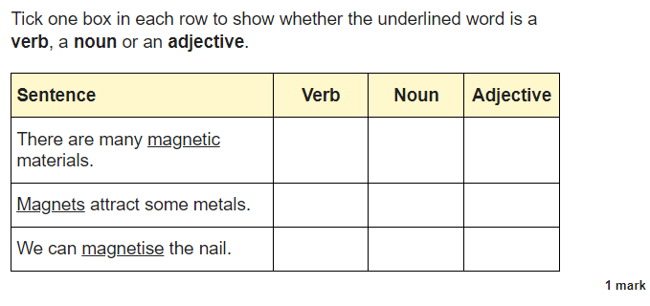
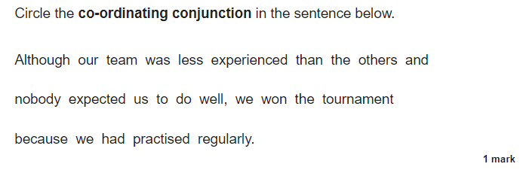
End of Key Stage 2 Assessments
By the end of KS2, children are expected to be able to use all of these grammar skills within their writing.
They will also sit the End of Key Stage 2 National Assessments which include a Spelling, Punctuation and Grammar paper. In this assessment, children will need to be secure in the names for the grammar devices/word classes.

Slide 11
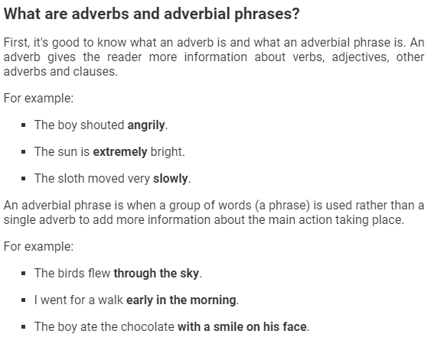
KS2 Grammar and Writing
Fronted adverbials

Slide 12
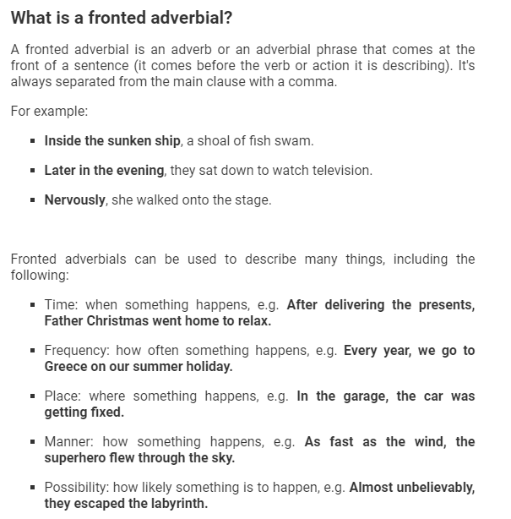
KS2 Grammar and Writing
Again, a fronted adverbial is a way of adding more information to the main clause. It always goes at the front of the sentence and needs to be punctuated with a comma.
Fronted adverbials will add:
When
Where
How

Slide 13
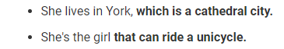
KS2 Grammar and Writing
Relative Clauses
Relative clauses add extra information about the noun in a sentence.
Because it's a clause that is dependent - which means it doesn't make sense on its own - it has to be linked to the main clause of a sentence for it to make sense.
They start with a relative pronoun - who, which, that, whom, whose, where, when
They can be punctuated with brackets, dashes and commas.

Slide 14
KS2 Grammar and Writing
Relative Clauses
Relative clauses add extra information about the noun in a sentence.
Because it's a clause that is dependent - which means it doesn't make sense on its own - it has to be linked to the main clause of a sentence for it to make sense.
They start with a relative pronoun - who, which, that, whom, whose, where, when
They can be punctuated with brackets, dashes and commas.

Slide 15
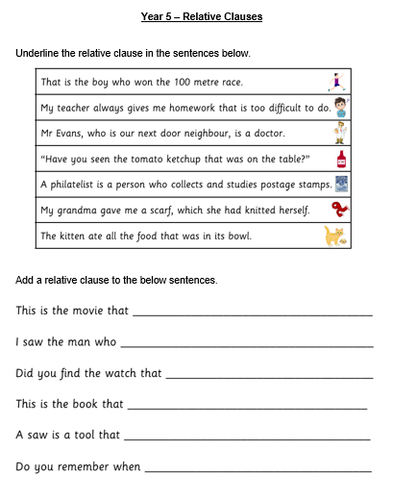
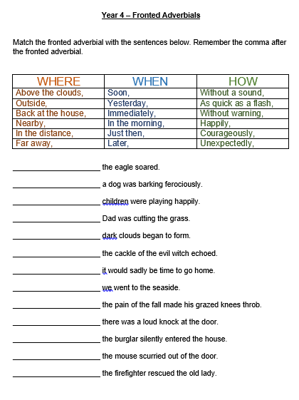
KS2 Grammar and Writing
Have a go…

Slide 16
Ways to help at home:
Children need to be familiar with the grammatical terms. When they are reading or writing at home, ask them questions like: What is the noun in the sentence? What adjective would you use to describe…?
Encourage Regular Writing: Suggest fun writing activities such as: Diaries or journals – writing about their day, feelings, or experiences. Story writing – encourage creativity by making up their own stories. Letters or emails – writing to relatives or friends. Reviews – of books, films, or days out. Give children a purpose for writing, such as making a shopping list or writing instructions for a game.
Discuss Vocabulary & Ideas: Encourage children to describe things in detail – ask questions like “What did it look/sound/smell like?”. Introduce new words in conversation and challenge them to use them in writing. Play games that develop vocabulary, such as word association, synonyms, or Scrabble.
Support with Grammar & Punctuation.Encourage them to read their work aloud – this helps spot missing punctuation or sentences that don’t flow. Remind them to check for capital letters, full stops, commas, and apostrophes in their writing. Practise grammar through fun activities like mad libs (fill-in-the-gap word games) or spotting grammar mistakes in their favourite books.
Read Together Often. Reading regularly helps improve spelling, vocabulary, and sentence structure. Discuss what they’ve read – ask about characters, settings, and predictions to develop comprehension and inference skills. Model fluent reading and point out interesting writing techniques (e.g., how an author describes a setting or builds suspense).
Encourage Editing & Improvement: Encourage children to reread their work and ask: Does this make sense? Can I use a more exciting word? Have I checked my punctuation? Show them that good writing takes time – authors edit multiple drafts before publishing!
Make Writing Fun! Try creative activities like: Writing short stories together, taking turns to add a sentence. Creating comics or graphic stories if they enjoy drawing. Using story prompts to spark ideas.

Slide 17

Feedback
Please take a moment to share your feedback with us

