Slide 1

Spelling and Reading
Miss Code

Slide 2

Spelling and Reading
Aims:
To explore how children progress in their spelling and reading after formal phonics teaching
To make links between a child's Phonics learning and how this supports their spelling and reading.
To understand how we teach Reading at Walton Oak

Slide 3
Spelling and Reading
Our Aims for Reading and Writing at Walton Oak:
Reading
We believe that the teaching of reading is integral to a child’s understanding and appreciation of the world around them; a platform that allows our children to see beyond what they know, share in cultural experiences and develop the vocabulary they need to effectively express themselves. Reading is at the very heart of our curriculum. We are committed to promoting a love for reading and not only giving children opportunities to read in English lessons, but in the wider curriculum too.
Writing
Writing is a crucial life skill. Our intent is to provide children with the skills to write fluently and communicate their ideas and emotions to others effectively while also developing their love for writing across the whole curriculum.

Slide 4
Spelling and Reading
Curriculum Coverage - Spelling
Year 2
Learn alternative spelling phonemes
Spell common exception words, contractions and homophones
Add suffixes -ment, -ness, -ful, -less, -ly
Year 3
Spell wide range of homophones
Spell words that are often misspelt
Use a wider range of prefixes and suffixes
Use a dictionary to spell words correctly

Slide 5
Spelling and Reading
Curriculum Coverage - Reading
Year 2
Discuss sequence of events in books
Make predictions and inferences
Read accurately (words of two or more syllables) by blending sounds, recognising alternative sounds for graphemes
Read further common exception words
Year 3
Identify themes and conventions
Identify main ideas across paragraphs and summarise these
Note unusual correspondence between spelling and sound
Apply growing knowledge of root words, prefixes and suffixes (etymology and morphology) to read aloud and understand new words

Slide 6
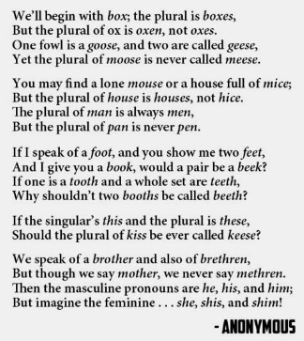
Spelling and Reading
English is tricky!
Notes:
To be confident in both reading and spelling, children need to have a good phonetic understanding.

Slide 7

Spelling and Reading
How do we teach Spelling at Walton Oak?
Following on from children's discrete teaching of Phonics, we move on to the Little Wandle Spelling Programme.
Little Wandle Spelling builds on children’s knowledge of the alphabetic code and teaches them how to spell with confidence. The programme provides a seamless link from the core Little Wandle programme to teaching spelling in Year 2 and beyond.

Slide 8
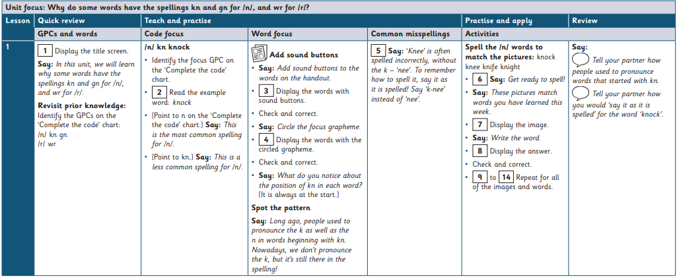
Spelling and Reading

Slide 9
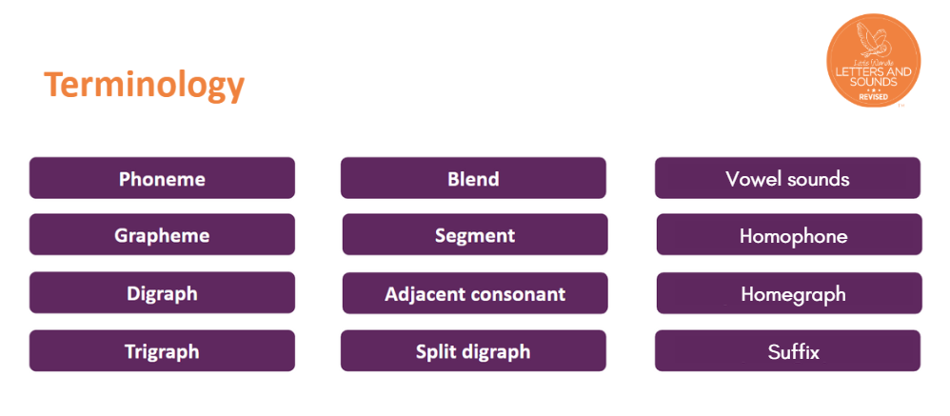
Spelling and Reading

Slide 10
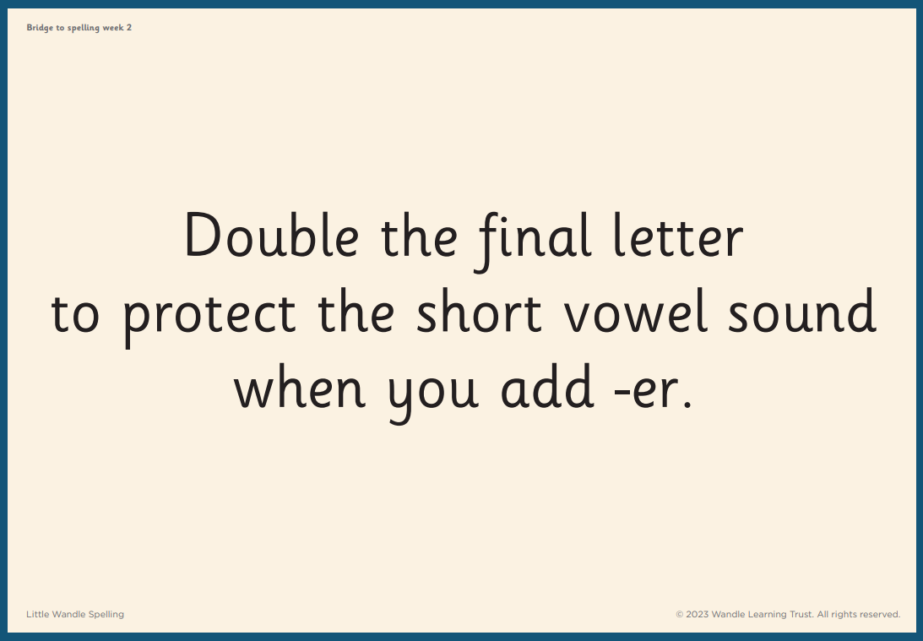
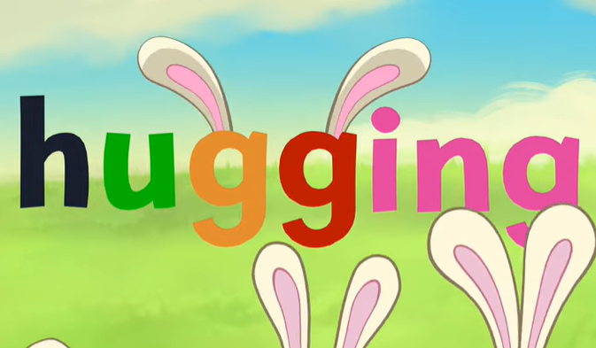
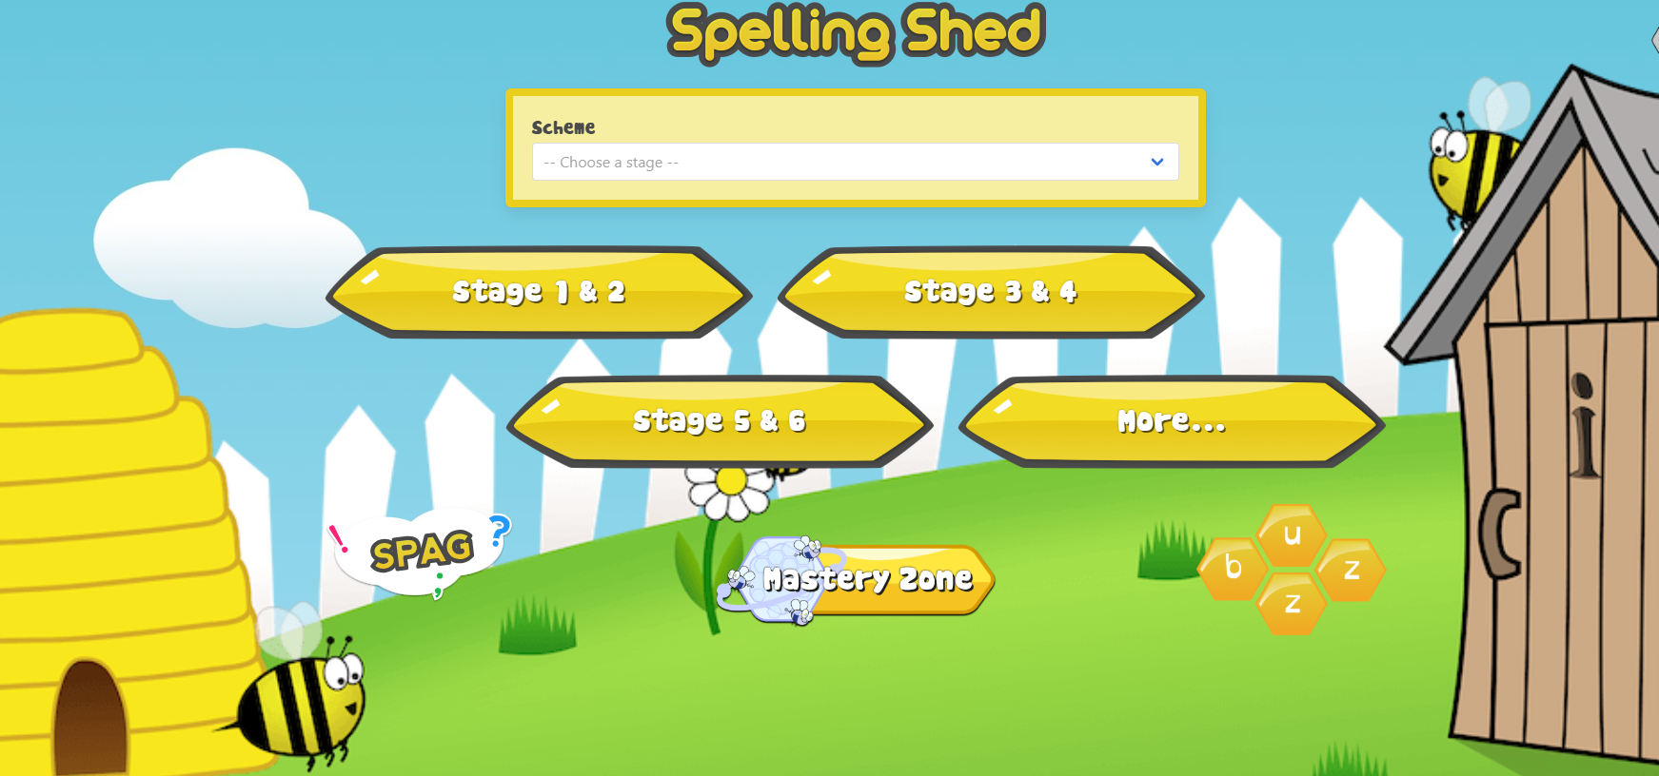
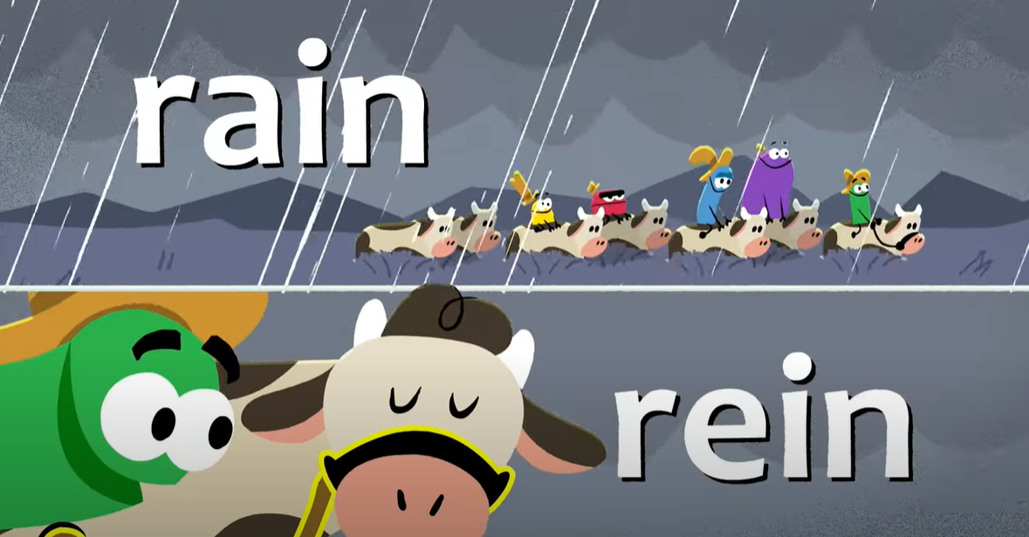
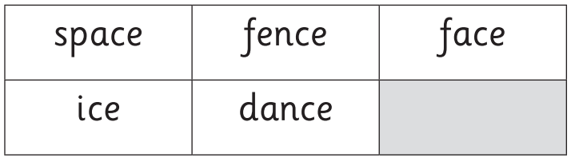
Spelling and Reading

Slide 11
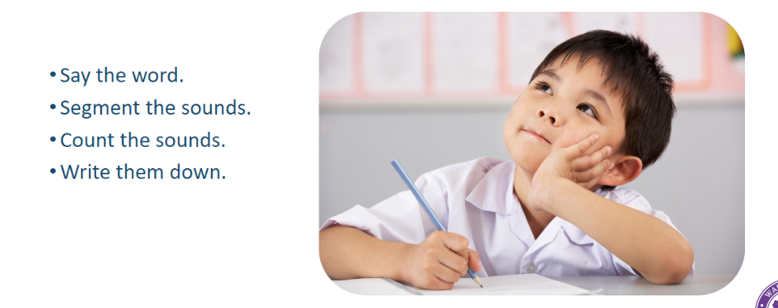
Spelling and Reading
Top Tips!

Slide 12
Spelling and Reading
“You can always edit a bad page. You can’t edit a blank page.”
– Jodi Picoult

Slide 13
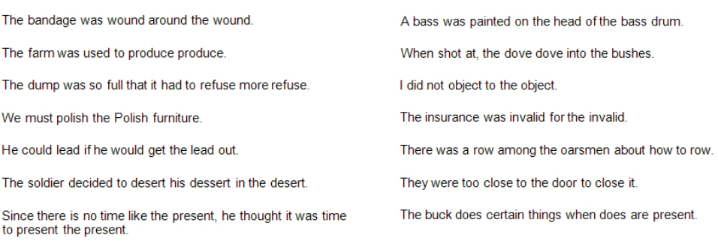
Spelling and Reading
English is tricky!

Slide 14
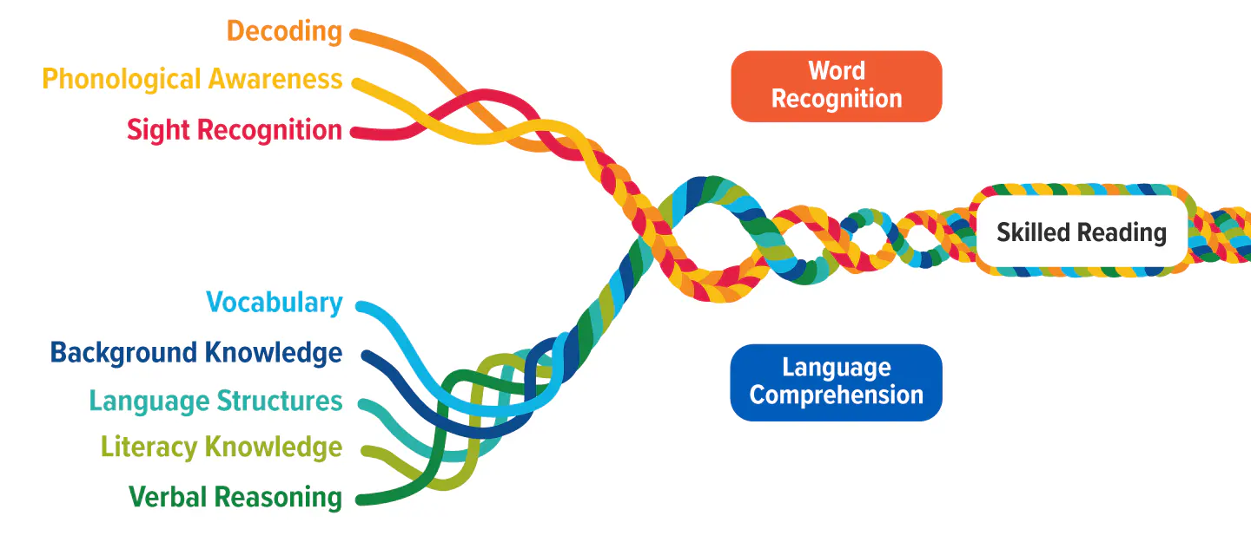
Spelling and Reading
The Reading Rope

Slide 15
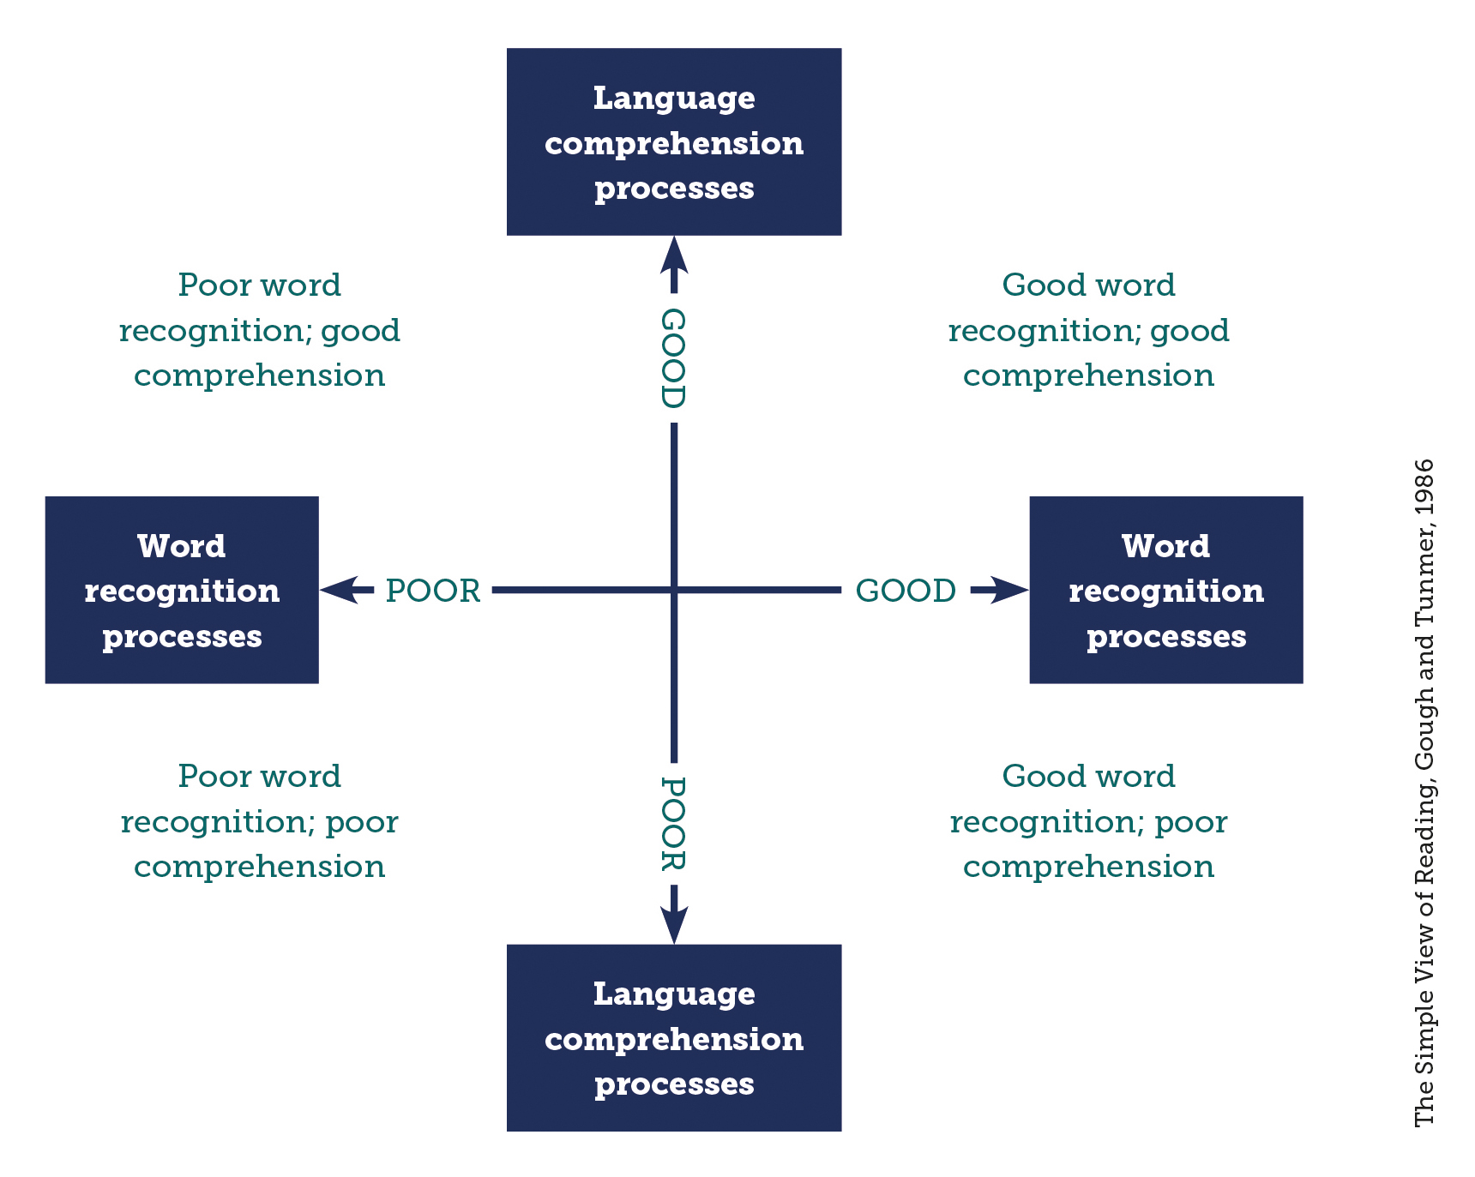
Spelling and Reading
The Simple View of Reading

Slide 16
Spelling and Reading
How do we teach Reading?
Word Recognition | Language Comprehension
*Phonics/Spelling *Reading banded books *Master Reader lessons | *Master Reader approach *Oracy

Slide 17

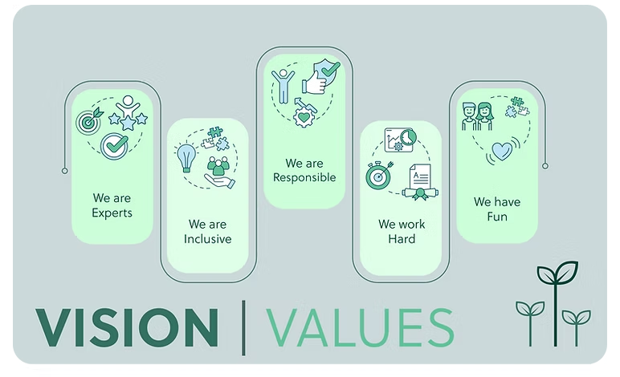
Spelling and Reading
Master Readers:
A systematic approach to teaching Reading.
Helps pupils to successfully transition out of a phonics programme into the world of books.
Uses a whole book approach to teaching reading so that pupils learn to enjoy reading a wide variety of genres written by a variety of authors.
Provides pupils with opportunity to discuss and share ideas.
Develops pupils' vocabulary so that they become masters at selecting words for impact.
Helps pupils acquire the skills needed to show their understanding when answering questions in discussion and when writing answers.

Slide 18
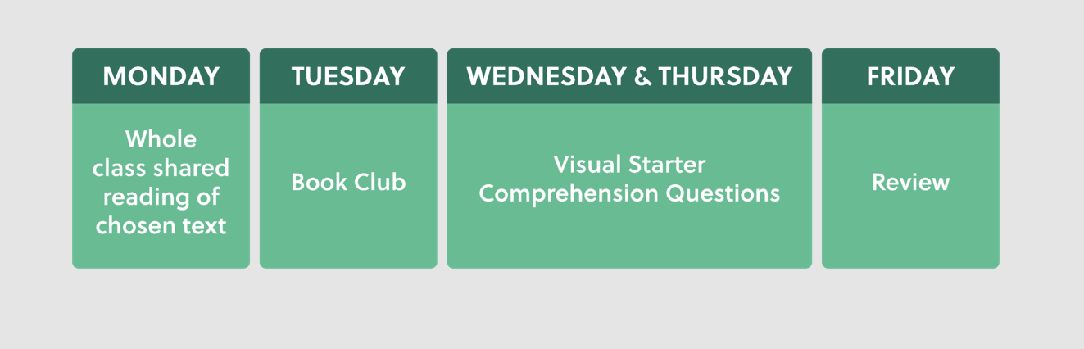
Spelling and Reading
Master Readers:

Slide 19
Spelling and Reading
Importance of Vocabulary
Developing fluency is complemented by expanding a pupil’s vocabulary. Familiarity with a variety of words helps pupils to read these words with greater ease. As a result, it improves not only fluency but also leads to more effective comprehension.
The Reading Framework (July 2023) discusses ‘Words that children are unlikely to hear in everyday conversation but are likely to come across in stories.’ These are the words that we teach through our Master Reader sessions.

Slide 20
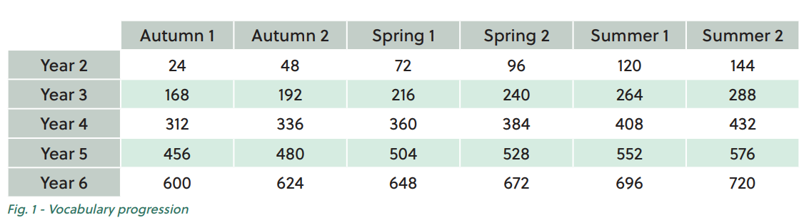
Spelling and Reading
Importance of Vocabulary

Slide 21
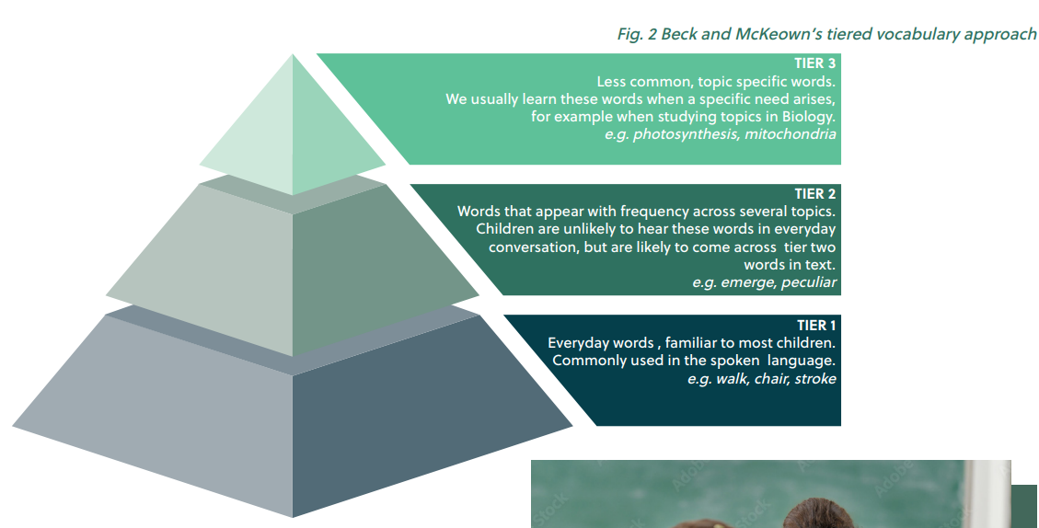
Spelling and Reading
Importance of Vocabulary

Slide 22
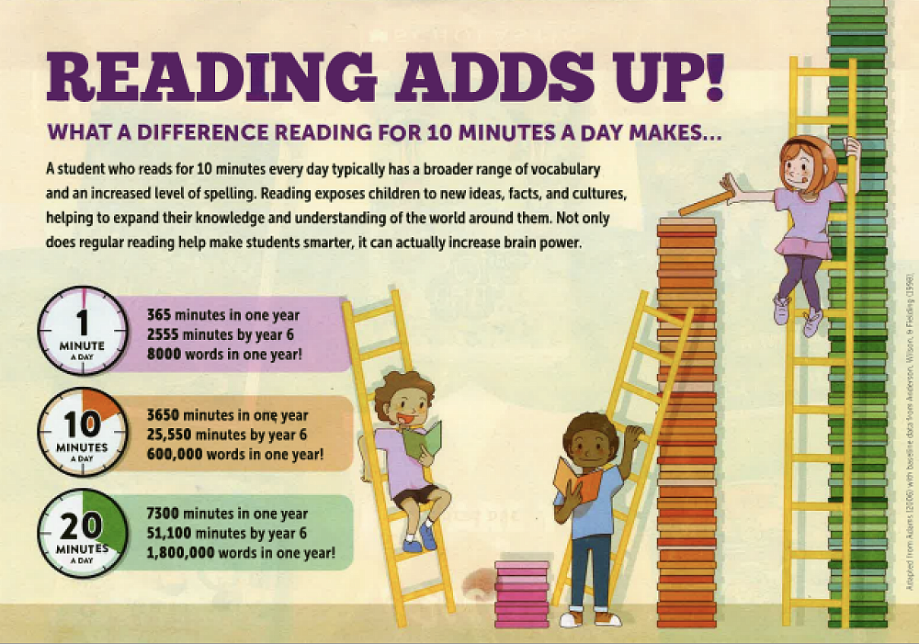
Spelling and Reading
Ways to help at home

Slide 23
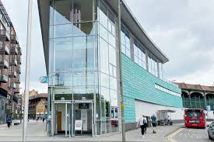


Spelling and Reading
Ways to help at home

Slide 24
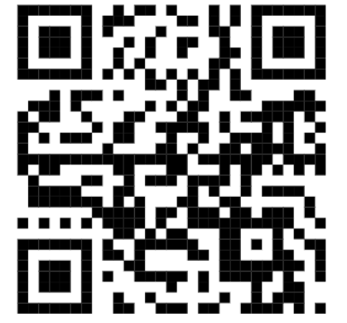
Feedback
Please take a moment to share your feedback with us

