Slide 1

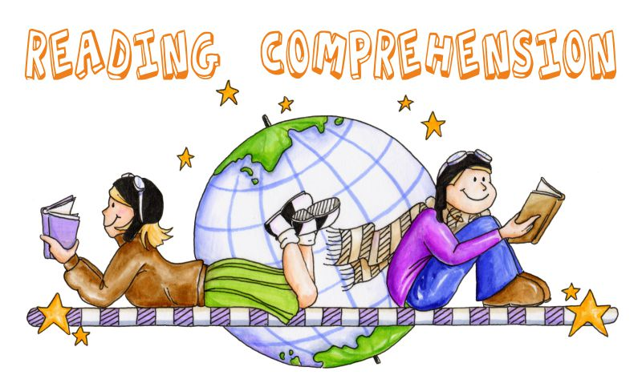

Reading Comprehension
Aims:
To understand the difference between reading fluently and reading for meaning
To have a clear understanding of comprehension
To be able to use questions effectively to enable reading comprehension

Slide 2
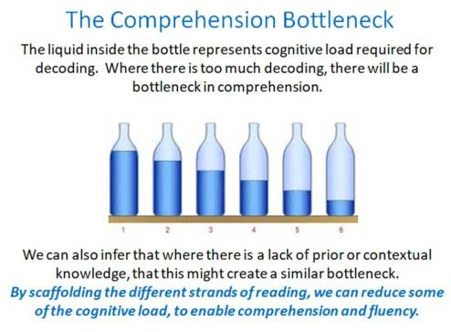
Reading Comprehension
What is fluency and why is it important?
For a child to be fluent, phonic knowledge is important.
When a child is fluent, we can focus on understanding and comprehension.
When comprehension is secure, the child will enjoy what they read.
Secure phonics and fluency all reduce cognitive load.

Slide 3
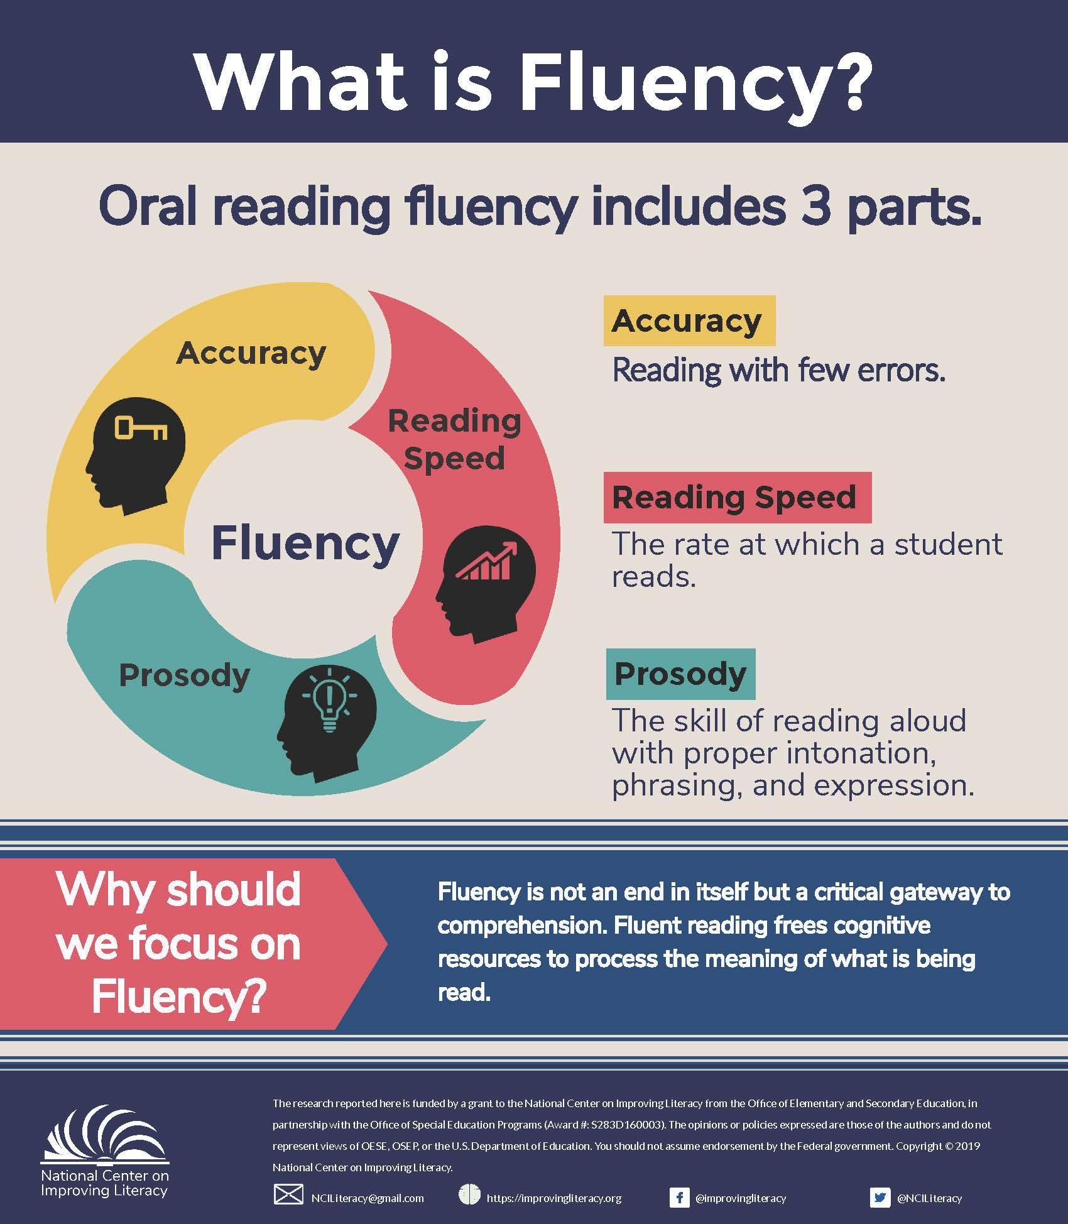
Reading Comprehension
Three ways you can help build fluency at home…
Read and follow – the adult reads the text and the child follows along with their finger. This helps the child with word recognition and models to them how they should read with fluency.
My turn, your turn – take turns reading a page or a paragraph. Here you are modelling how to read with fluency, flow and expression.
Echo Reading – as you read, the child copies. It is important here to pace yourself and read at a rate that your child can keep up with.

Slide 4
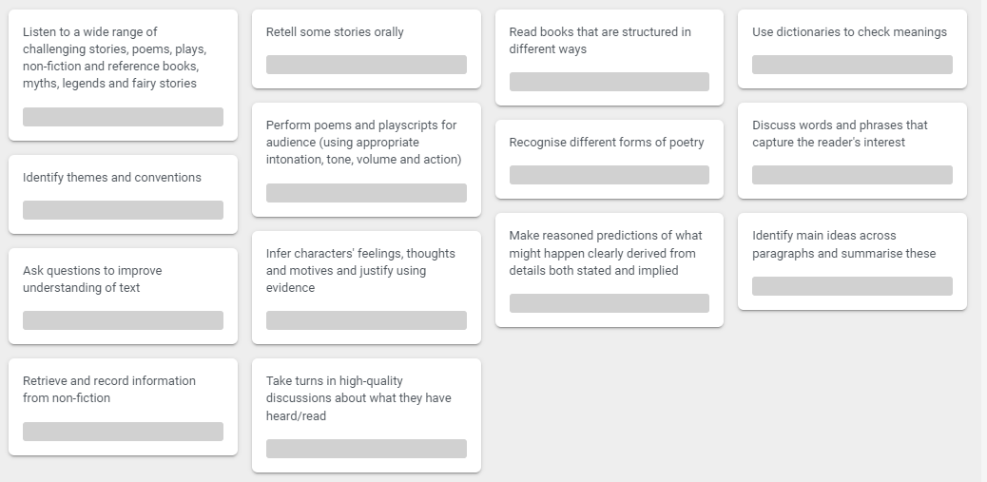
Reading Comprehension
Year 4

Slide 5
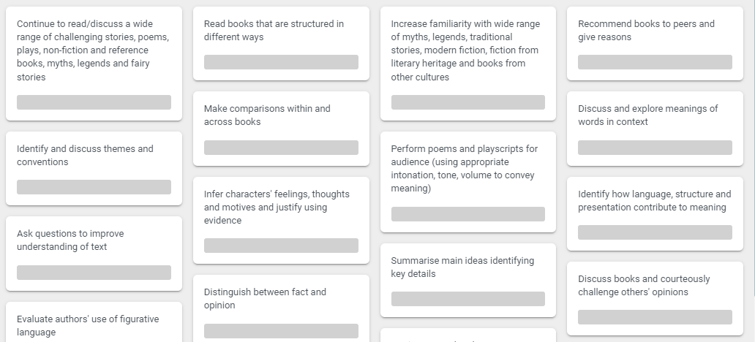
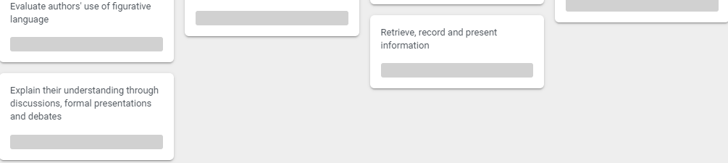
Reading Comprehension
Year 5 and Year 6

Slide 6

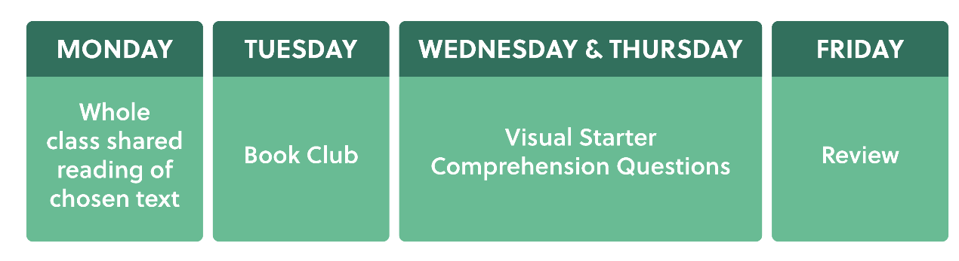
Reading Comprehension
Our approach
This year, we have adopted a new approach to reading. Every year group follows this structure in their reading lessons everyday.

Slide 7
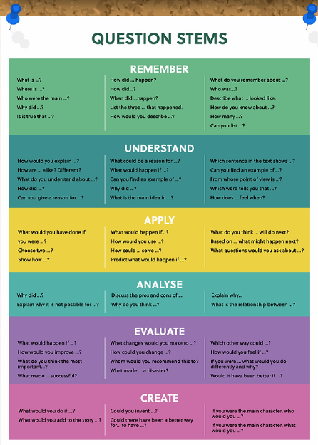
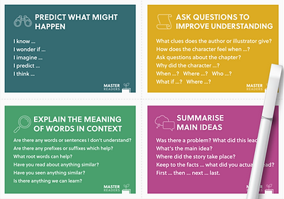
Reading Comprehension
On your tables are the support cards that the children have access to during book club on a Tuesday.

Slide 8
Reading Comprehension
Comprehension questions
On the Wednesday and Thursday lessons of reading, we focus on comprehension questions.
In Lower KS2, we focus on 3 comprehension questions a lesson. These questions are a range of retrieval, inference, vocabulary, author's choice and prediction questions.
In Upper KS2, the children are challenged to complete 5 comprehension questions a lesson. They complete one of each style of question every comprehension lesson.
By the end of Year 6, this enables the children to be confident with answering a range of comprehension questions, supporting them in the SATs reading paper and beyond.

Slide 9
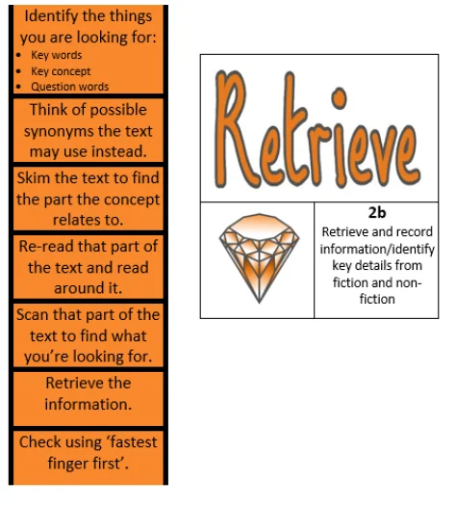
Reading Comprehension
Retrieve
Retrieval of information is often the starting point for discussing a text. This means picking the exact (spelling and punctuation too) information out of the text that they have just read.
For example:
What was the character’s name?
What did they eat for dinner?
What colour was the car?
What time did…

Slide 10
Reading Comprehension
Inference-
Is an interpretation that goes beyond the literal information given and relies on the evidence within the text as well as background knowledge.
The police find a threatening letter addressed to the victim.
We could infer that someone didn’t like that person.
The bike lay on the floor next to her as she held her leg and cried.
We could infer that the girl fell off her bike.
My stomach rumbled as the smell of dinner wafted from the kitchen.
We could infer that this person is hungry.

Slide 11
Reading Comprehension
Vocabulary -
Interpreting words in context and deciphering the meaning of words unknown based on the context they are written.
Mr Ali loathes wearing a tie as he finds it uncomfortable.
We may not know the meaning of the word ‘loathe’ here but based on the context and other evidence within the sentence, we can guess it means ‘doesn’t like’. How have I arrived at this conclusion?
Beowulf was incensed by Grendel’s attack and vowed revenge.
We may not know the meaning of the word ‘incensed’ here but we can guess it means ‘angered’. How have I arrived at this conclusion?

Slide 12
Reading Comprehension
Predict –
What has or what will happen based on information stated or inferred (linked closely to inference). Again, background knowledge here is important.
Beowulf snatched his sword from the armoury and ran towards the mountains.
  What do you predict Beowulf is going to do? What evidence is there in the text?
Predictions, like inferences, are neither right or wrong; they may be strong (with secure evidence to back them up) or weak (with little or poor evidence to back them up).

Slide 13
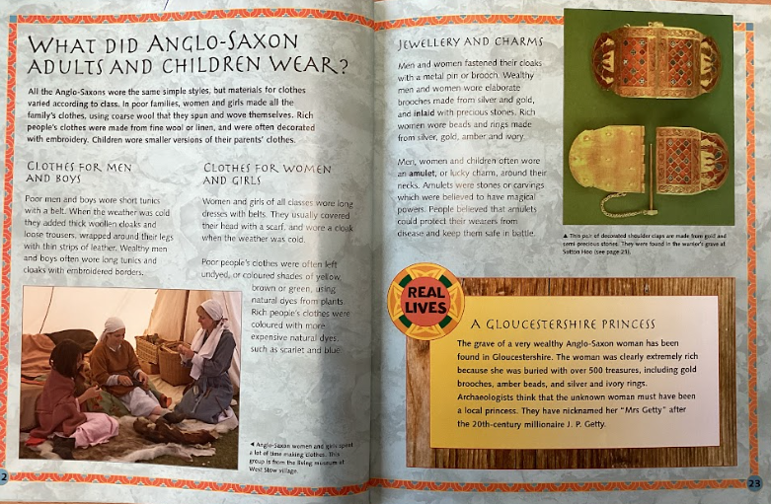
Reading Comprehension
Author’s Choice–
Author's choices can include decisions about narrative structure, such as point of view and pacing, which impact how the story unfolds. By analysing an author's choices, readers can uncover deeper meanings and themes that may not be immediately apparent in the text.
  Why has the author included ‘Real Lives’ sections in the book?The author has included a 'Real lives' section to the book to inform the reader about real people who lived during the Anglo-Saxon period.

Slide 14
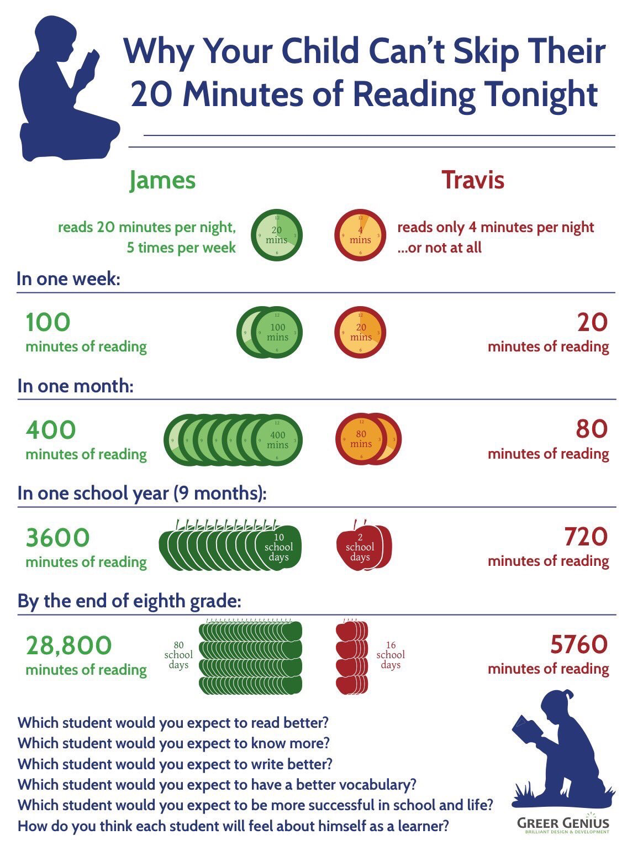
Reading Comprehension
Why is reading at home vital?

Slide 15
Reading Comprehension
How to encourage independent reading at home:
Having books that the child owns
Using the school and local library to help build variety
Exposing children to texts beyond novels e.g. comics, magazines, non-fiction books
Taking control of screens – reading first and then screen time
Show that you love reading… even if you have to do a bit of acting
Give children books that matter to them
Reward reading through extrinsic and intrinsic motivators

Slide 16
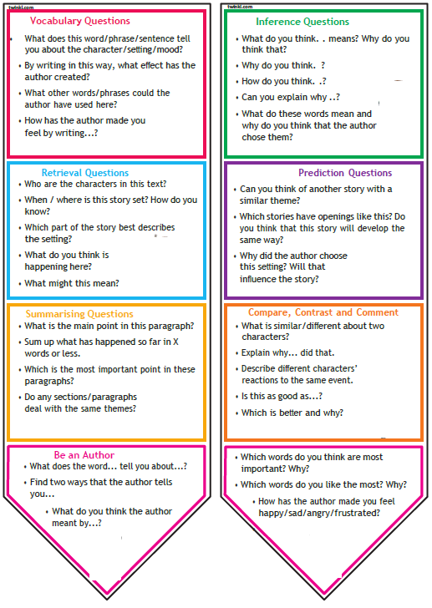
Reading Comprehension

Slide 17

Have a go…
Please take the time to have a look at the example of the Comprehension activity - feel free to have a go.

Slide 18

Feedback
Please take a moment to share your feedback with us

