Slide 1


Maths strategies & representations
Aims:
Understand the Importance of Representations : How visual methods help children grasp mathematical concepts.
Explore Key Maths Strategies for Year 2 & Year 3: Place value, Formal methods for addition & subtraction, multiplication & division.
Support Learning at Home : Simple ways parents can reinforce strategies using everyday objects.

Slide 2
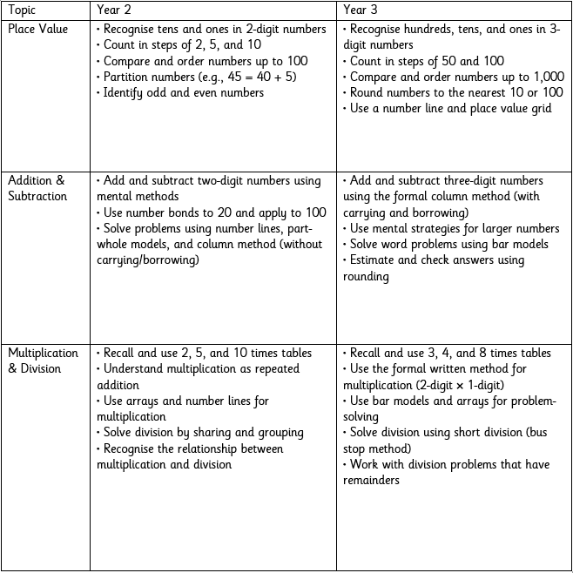
Maths strategies & representations
Curriculum Coverage
Included in the handout

Slide 3
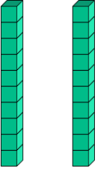
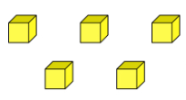
Maths strategies & representations
Place value
Understanding place value is crucial for all maths concepts. It helps children break numbers into tens and ones to make calculations easier.
In Year 2 and Year 3, we use practical tools like Base 10 blocks, place value charts, and counters to reinforce this concept.
Tens
Ones
The Number 45, here we are using base 10 to represent the number.
We can see 45 is made up of 4 tens (40) and 5 ones (5). This understanding helps children when adding, subtracting, and working with larger numbers

Slide 4
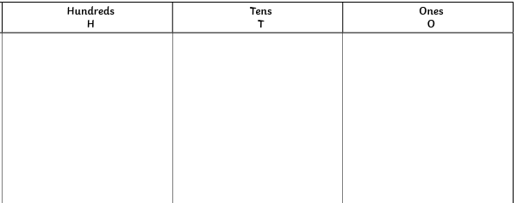
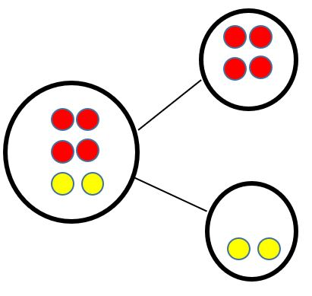

Maths strategies & representations
Place value
Place Value Chart- Organises numbers clearly to show their value.
Number Line Representation- Helps children count forwards/backwards easily.
Counters (Part-Whole Model)- Builds number sense and prepares for addition/subtraction.
Notes:
Year 2- T, O
Year 3- H, T, O

Slide 5
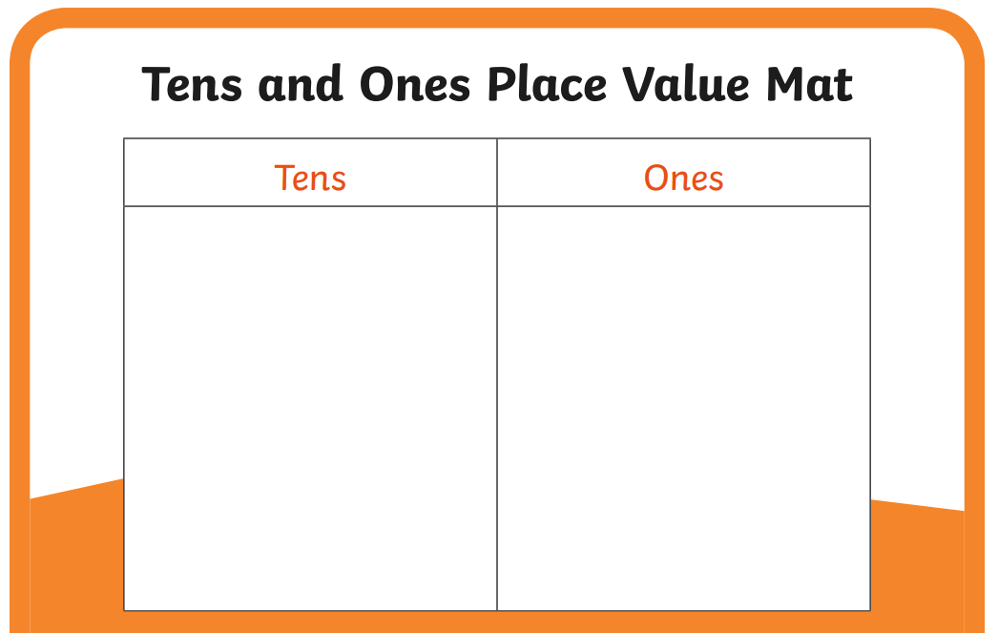
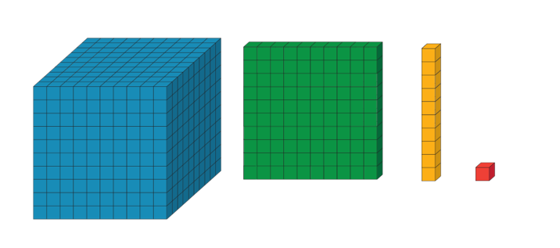
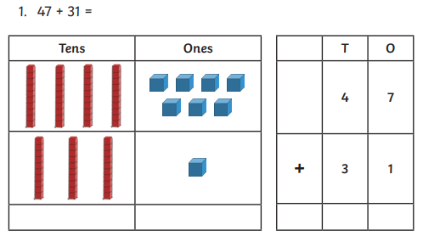
Maths strategies & representations
Key Skills Covered in Year 2:
Add and subtract numbers up to 100
Use number bonds to 10 and 20 to support calculations
Add and subtract two-digit numbers using different methods
Understanding inverse relationships (e.g., if 12 + 8 = 20, then 20 - 8 = 12)
Solving simple word problems involving addition and subtraction
Year 2 adding + subtracting
To deepen understanding, at Walton oak we use the CPA approach, moving from hands-on materials to visual representations before working with numbers alone.
1-
Concrete (Using objects)- Children begin by using physical objects to represent numbers and calculations.
2-
Pictorial (Drawing Representations)- Once children understand using objects, they move on to drawing pictures to represent calculations.
3-
Abstract (Using Numbers Only)- Once children are confident, they move to working with just numbers and symbols.
Notes:
Apply to addition and subtraction
Start in the ones column

Slide 6

Maths strategies & representations
Year 3 - Adding using the formal method
Example: 247 + 86
Step 1: Write the numbers in columns (Hundreds, Tens, Ones)
Step 2: Add Ones (7 + 6 = 13, put 3 in Ones column, carry over 1 to Tens
Step 3: Add Tens (4 + 8 = 12, plus 1 carried over = 13, put 3 in Tens, carry 1 to Hundreds)
Step 4: Add Hundreds (2 + 1 = 3)
Answer: 247 + 86 = 333
H | T | O
2 | 4 | 7
 | 8 | 6
+

Slide 7

Maths strategies & representations
Year 3 - Subtraction formal method with borrowing
Example: 345 - 78
Step 1: Write the numbers in columns
Step 2: Subtract Ones (5 - 8 is not possible, so we borrow 1 from Tens column, making it 15 - 8 = 7)
Step 3: Subtract Tens (3 - 7 is not possible, so we borrow 1 from Hundreds, making it 13 - 7 = 6)
Step 4: Subtract Hundreds (2 - 0= 2)
345 - 78 = 267
H | T | O
3 | 4 | 5
 | 7 | 8
-

Slide 8
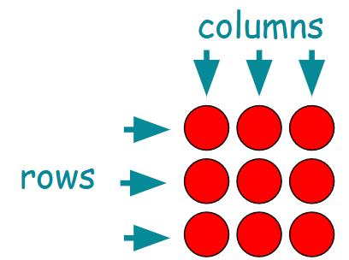
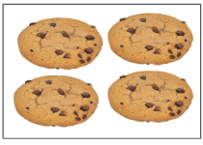

Maths strategies & representations
Year 2 multiplication + division
Key Skills Covered in Year 2:
Understanding multiplication as repeated addition (e.g., 3 × 4 is the same as 4 + 4 + 4)
Understanding division as sharing and grouping
Using arrays to represent multiplication and division
Learning and recalling 2, 5, and 10 times tables (and beginning 3s)
Solving simple word problems involving multiplication and division
1-
Arrays- An array is a way of arranging objects in rows and columns to help children understand multiplication and division visually.
An array is made up of equal rows and columns.
3 x 3
Grouping- Children learn that multiplying is making equal groups.
2-
Sharing- Division can be done by sharing objects equally.
3-
Times Tables- learn to count in 2s, 5s, and 10s to build fluency.
4 x 3 = 12
12 ➗ 3 = 4

Slide 9
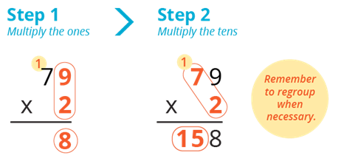
Maths strategies & representations
Year 3- Multiplication using the formal methods
Step 1: Write the Numbers in Columns - Align the 2-digit number above the 1-digit number.
T | O
2 | 4
 | 3
Step 2- Multiply the Ones- Multiply 4 (Ones) × 3 = 12. Write 2 in the Ones place and carry over 1 to the Tens.
X
Step 3- Multiply 2 (Tens) × 3 = 6. Add the carried-over 1 (6 + 1 = 7). Final answer: 72
Key skills :
Recall and use 3, 4, and 8 times tables
Use the formal written method for multiplication (2-digit × 1-digit)

Slide 10
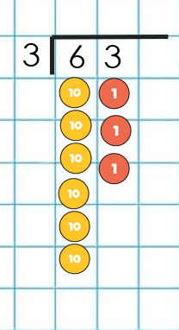
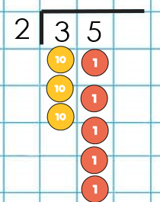
Maths strategies & representations
Year 3- Division using the formal methods
Regrouping & Remainders
Look at the tens (30): Group the yellow counters into sets of 2. You have 1 full group of 20.Leftover tens (10) are exchanged for 10 ones.
Look at the ones (15): Group the red counters into sets of 2. You have 7 full groups with 1 counter left over. That leftover counter is a remainder.
Look at the tens (60) -Group the yellow counters into sets of 3. You have 2 groups of 30 in each set .
Look at the ones (3)- Group the red counters into sets of 3. You have 1 group of ones → That’s 1 per group.

Slide 11
Maths strategies & representations
Key Vocabulary:
Place Value & Number Sense
Year 2
Digit – A single number (e.g., 4, 7, 9).
Place Value – The value of a digit based on its position.
Tens and Ones – Understanding numbers as groups (e.g., 45 = 4 tens and 5 ones).
Partitioning – Breaking a number into parts (e.g., 32 = 30 + 2).
Greater than (>) / Less than (<) / Equal to (=) – Comparing numbers.
Year 3
Hundreds, Tens, and Ones – Understanding 3-digit numbers.
Rounding – Approximating numbers to the nearest 10 or 100.
Estimate – Making an educated guess.
Addition & Subtraction
Year 2
Add, Sum, Total, Plus – Words for addition.
Subtract, Take Away, Difference – Words for subtraction.
Number bonds – Pairs of numbers that make a given total (e.g., 7 + 3 = 10).
Part-Whole Model – A way to break numbers into parts for understanding operations.
Year 3
Column Method – Formal written method for addition and subtraction.
Exchanging/Borrowing – Moving values between place values when subtracting.
Multiplication & Division
Year 2
Multiply, Groups of, Lots of, Times – Words for multiplication.
Array – A visual representation using rows and columns.
Repeated Addition – Using addition to solve multiplication (e.g., 3 × 4 = 4 + 4 + 4).
Sharing, Equal Groups – Concepts for division.
Year 3
Times Table – Multiplication facts (e.g., 3 × 4 = 12).
Division, Divided by, Quotient – Words for division.
Remainder – The amount left when a number cannot be divided equally.
Bar Model – A visual way to represent multiplication and division

Slide 12

Maths strategies & representations
Ways to help at home
Use real life objects to practise
Multiply e.g., "We have 12 biscuits between 4 of us, how many biscuits do we get each?"
Encourage drawing number lines, arrays or counting
Play games counting in 2s, 5s and 10s, play simple board games that involve counting forward and back
Use real-life situations
e.g., "We have 15 apples, if we eat 4, how many are left?", “share the sweets equally”
Times Table rockstars
Reviewing Jungle/Rainbows maths games

Slide 13
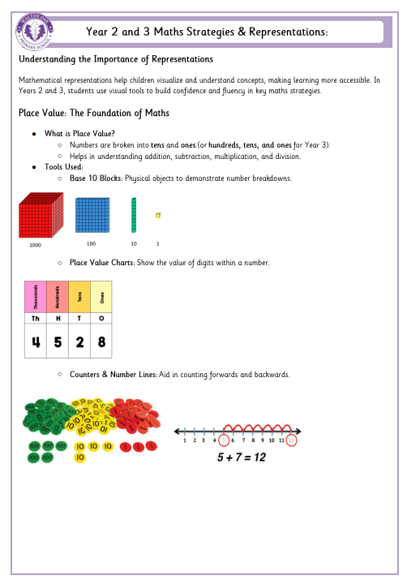
Maths strategies & representations
Handout
Please take a handout .

Slide 14
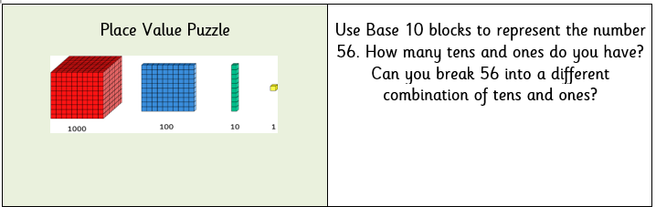
Maths strategies & representations
Now it's your turn to solve some math problems!

Slide 15

Feedback
Please take a moment to share your feedback with us

