Slide 1



Early Number
Aims:
To share the key elements of the Early Number curriculum with parents.
To equip parents with ways to support with their child's Maths learning at home.
Positive Attitude
The most effective support that you can give is to be enthusiastic and excited by maths.

Slide 2
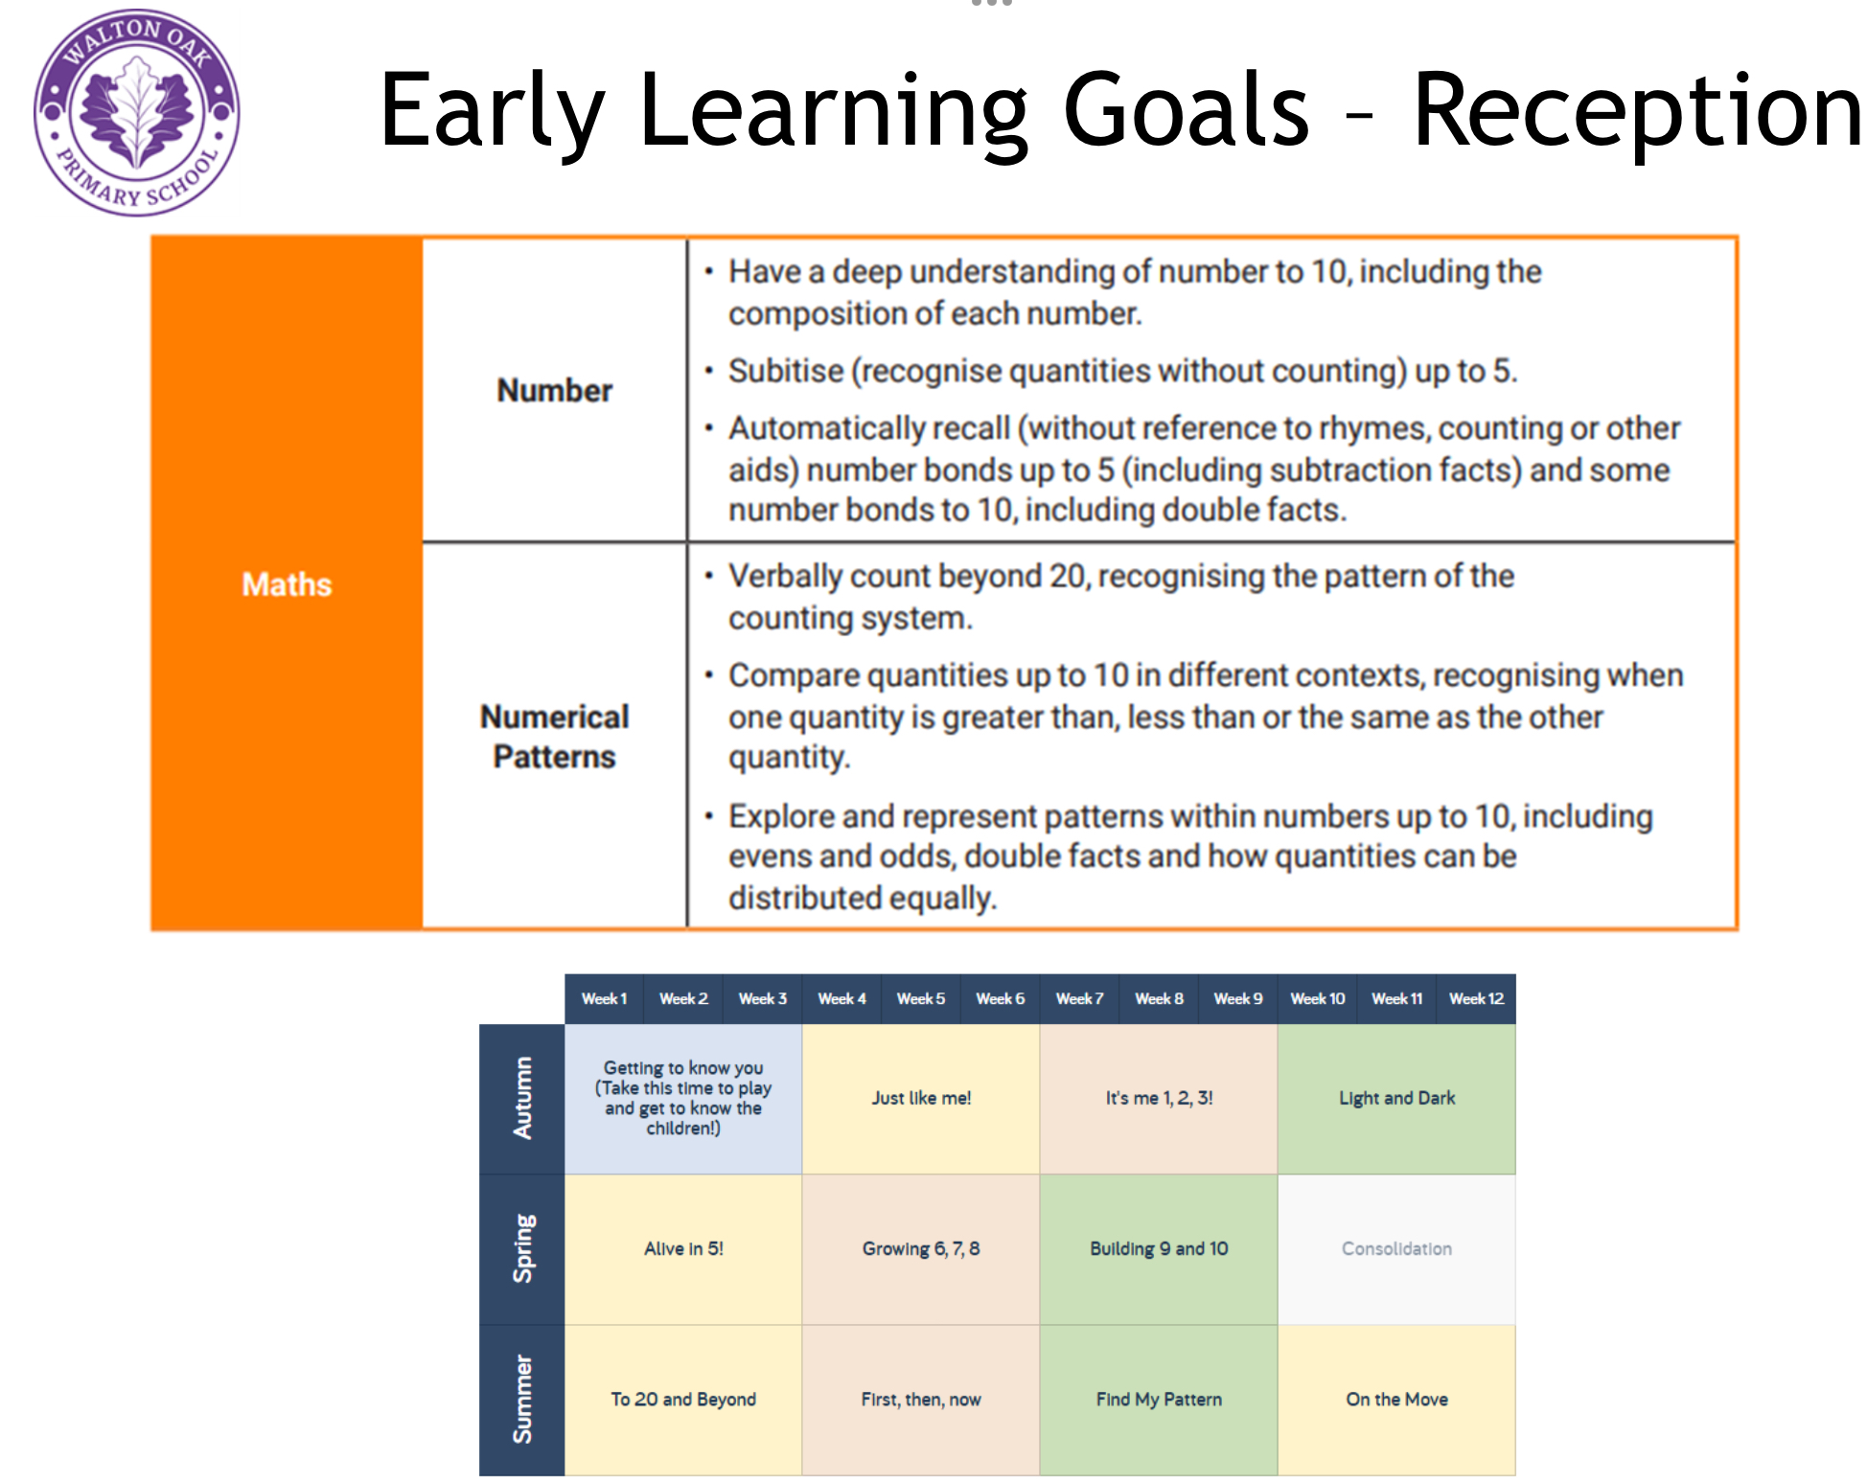
Early Number
Curriculum Coverage

Slide 3
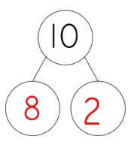

Early Number
Composition - Putting together two numbers or two parts to make a larger number or a whole.
Subitising - The ability to look at a small set of objects and instantly know how many there are without counting them.
Automatic Recall - they can quickly retrieve answers from memory without having to rely on counting procedures, such as counting on fingers.

Slide 4
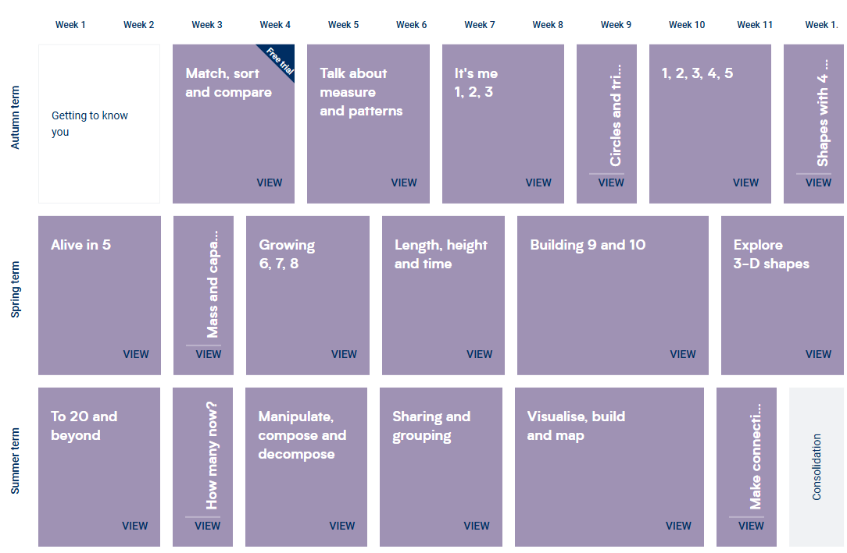
Early Number
Curriculum Coverage
This is the sequence of maths learning in Reception.
Learning concentrates heavily on number.

Slide 5
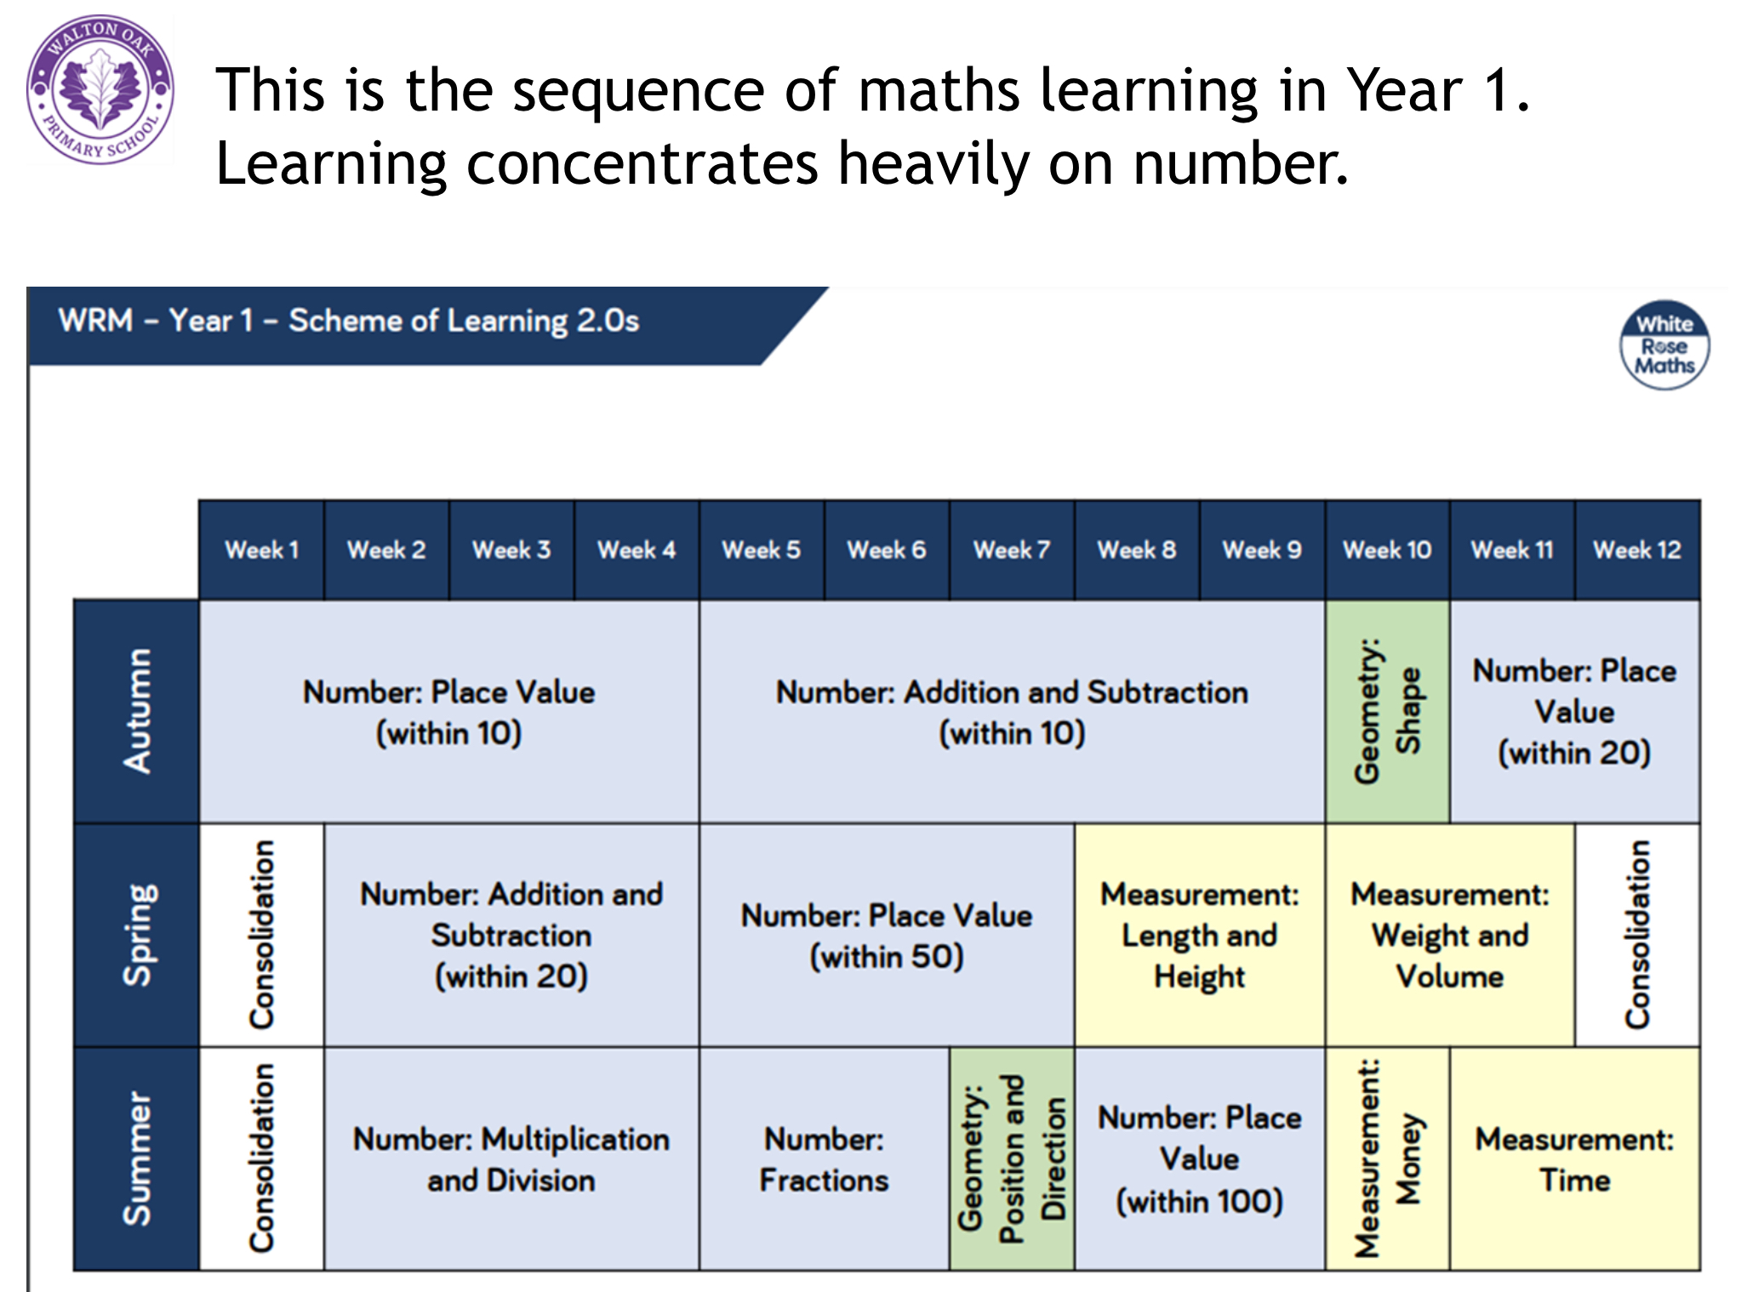
Early Number
Curriculum Coverage

Slide 6
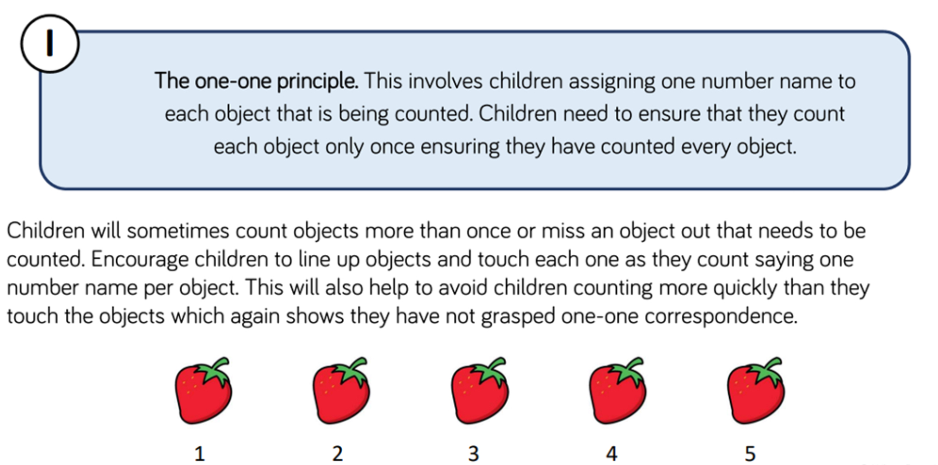
Early Number
There are 5 counting principles:

Slide 7
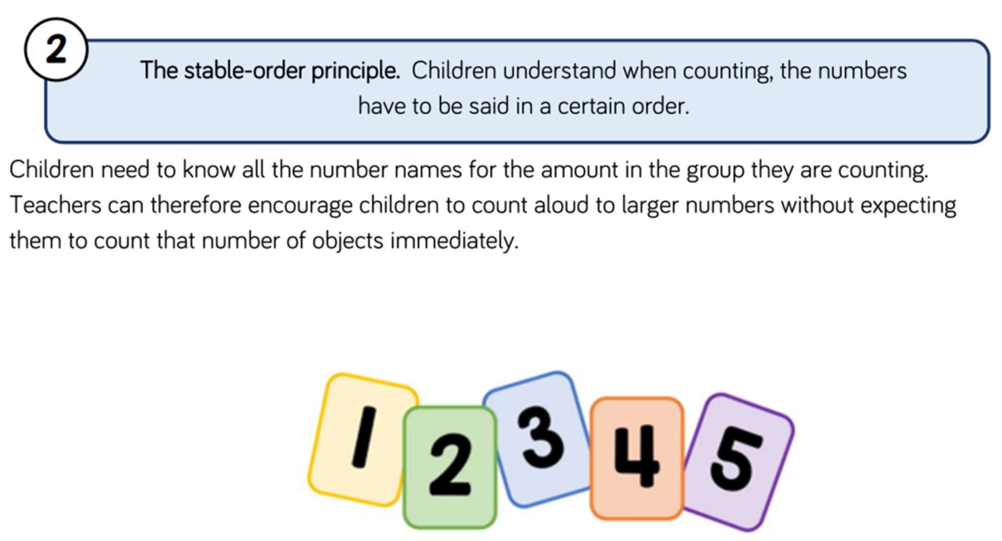
Early Number

Slide 8
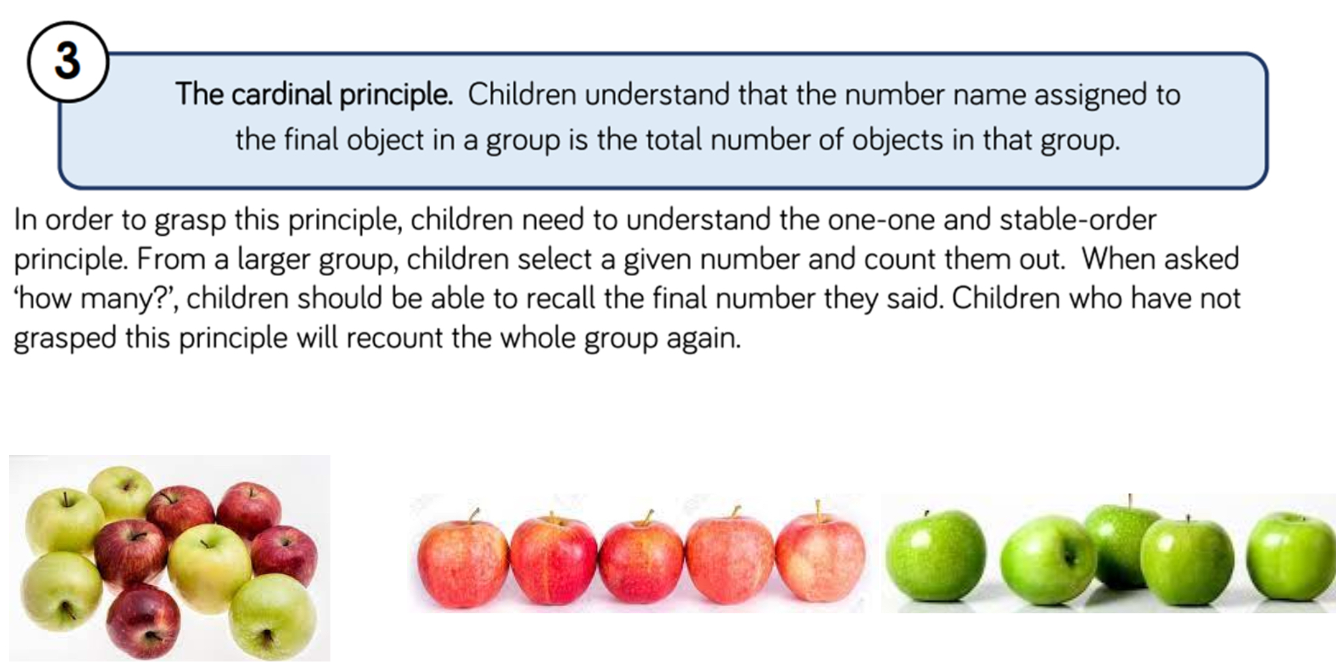
Early Number

Slide 9
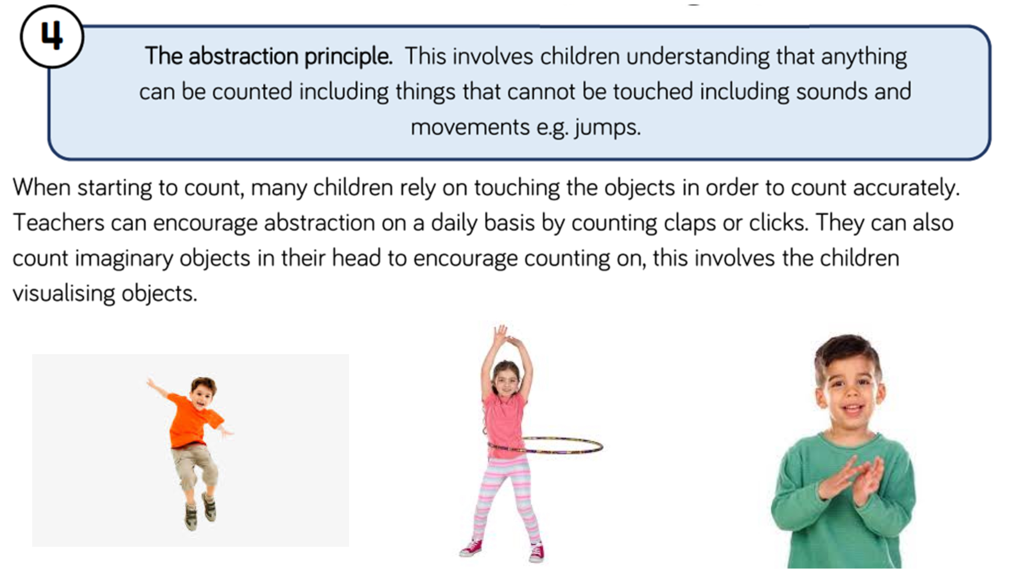
Early Number

Slide 10
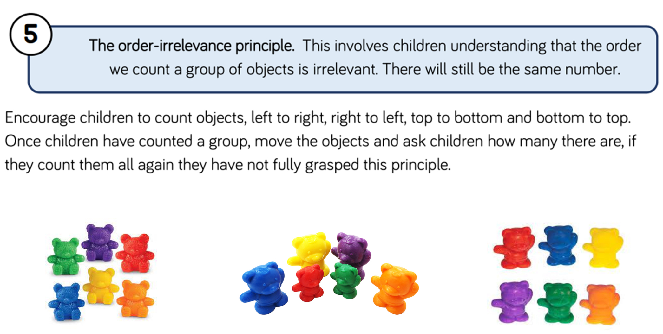
Early Number

Slide 11
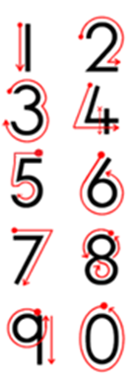

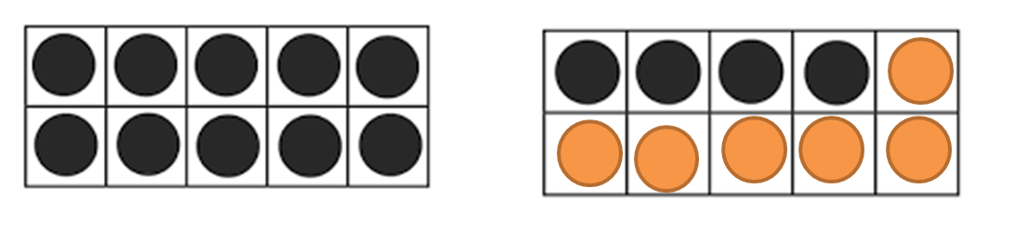

Early Number
Key Vocabulary:
Conservation (of number) is the recognition that the number stays the same if none have been added or taken away.
Numeral is the written symbol for a number e.g. 4
Ordinal is a number which states the position in a sequence
e.g. 1st, 2nd or page 1, page 2.
Partition is the word we use to separate/split a set into 2 or more subsets e.g. you can partition 10 items into one group of 4 and another group of 6. There are many ways to partition numbers.
Subitising is the word we use when we instantly recognise a small quantity without having to count how many are there.

Slide 12
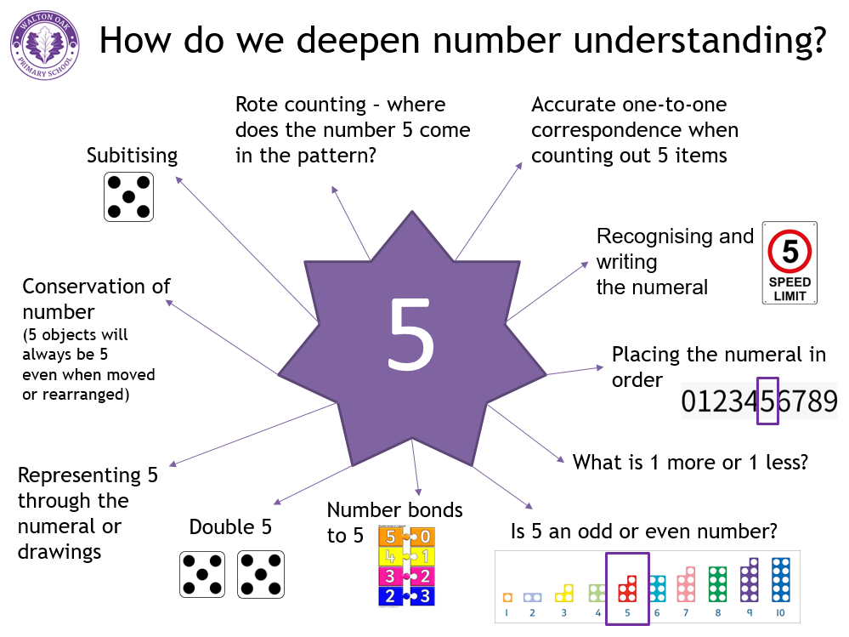
Early Number

Slide 13
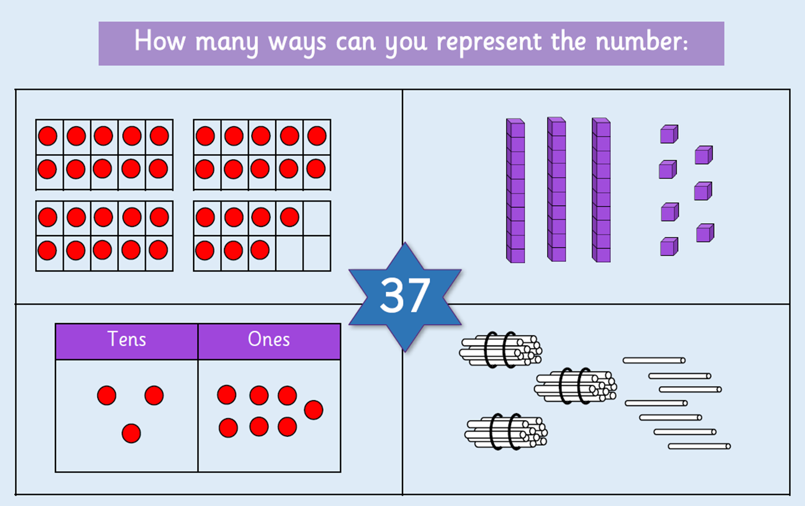
Early Number
Your turn!

Slide 14
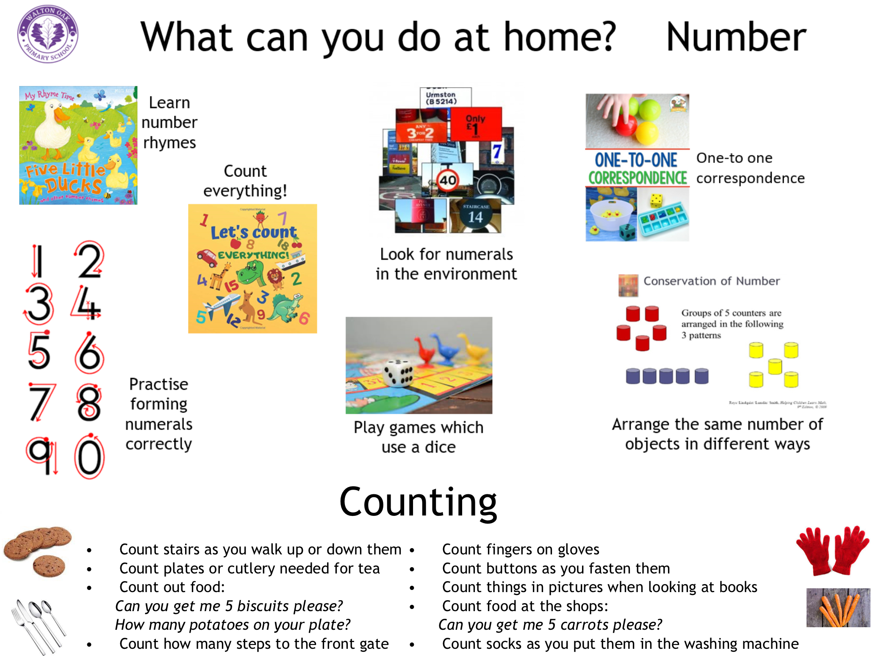
Early Number

Slide 15

Feedback
Please take a moment to share your feedback with us

