Slide 1
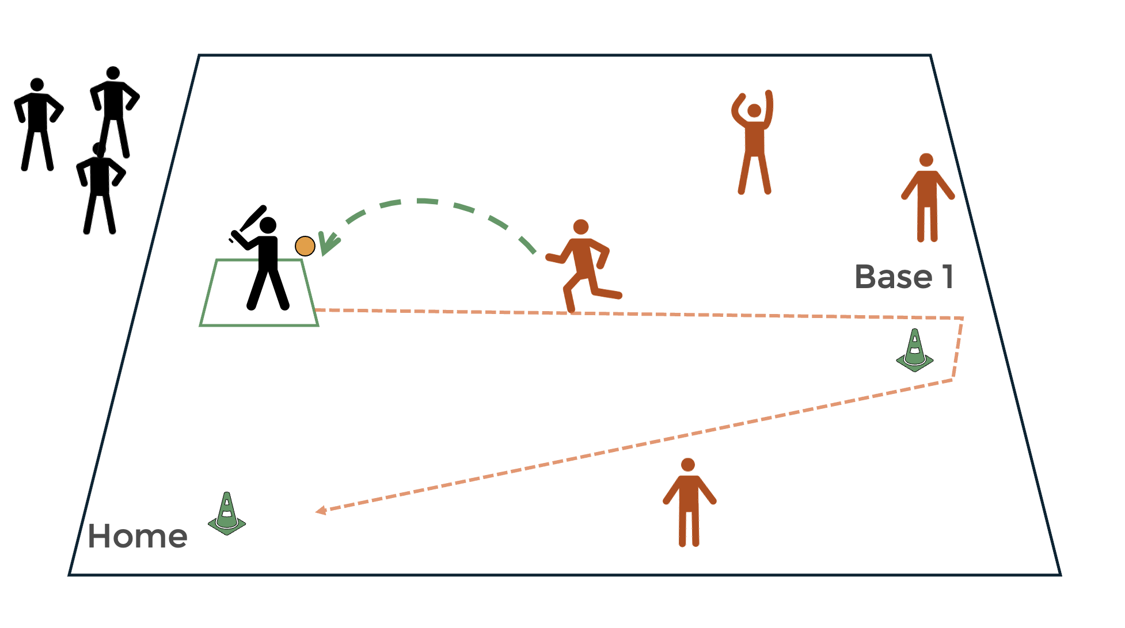
Year 3 - Rounders
Experienced different games and activities where throwing and catching skills were used. Had the opportunity to hit and strike a ball with racquets and bats. Played in simple, striking and fielding games.
To be able to play simple rounders games. Apply some rules to games and develop and use simple rounders skills.
to get into the best body position to field a ball.
to bowl with some consistency in a game.
to hit a moving ball with one hand.
to stop a moving ball with the long barrier technique.
to throw longer distances using the overarm technique.
to select and apply new skills in a competition.
Why do we need to return the ball to the bowler/bases as quickly as we can when fielding?
Why do we need to be directly behind the ball before getting into the long barrier position?
Why is the forward-stepping action significant when bowling?
A range of balls, a range of bats and striking equipment, bases, button cones, batting cone, posts.
Batting, fielding, bowling, bases, long barrier, batter, bowler, fielder, innings, no ball, batting box, backstop, rounders, half rounders.
Batters will face a certain number of balls each or play within a time limit.
If a batter hits the ball, they must run around the bases (as many as they want).
Head - Explain the importance of being ready in the field.
Hand - Bowl an underarm ball.
Heart - Identify how to improve own and other’s work and be tactful.

