Slide 1
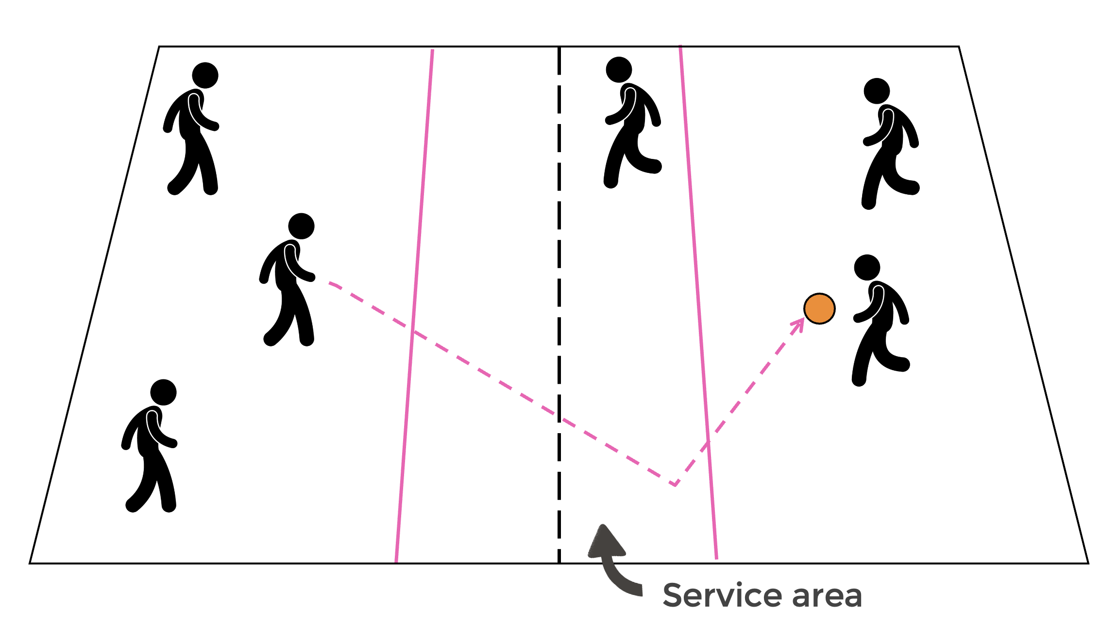
Year 2 – Send and Return Unit 1
Developed sending skills with a variety of balls. Tracked, intercepted and stopped a variety of objects. Selected and applied skills to beat the opposition.
Be able to track the path of a ball over a net and move towards it. Begin to hit and return a ball with some consistency. Play modified net/wall games throwing, catching and sending over a net.
to stay on our toes to move quickly to the ball.
to identify which hand is dominant in a game.
the basic rules of serving to our partner.
to develop agility and use it in a game.
to use the correct grip to hit a self-fed ball.
to use the ready position in a rally.
How do you hold the racquet differently for the different types of hits?
What is a self-feed?
What is a boundary?
Why do you think we have boundaries?
A variety of balls, a variety of bats/racquets, cones, hoops, targets, button cones, quoits, balloons, bench.
Serve, bounce, drop, badminton, tennis, volleyball, squash, shuttlecock, racquet.
Children can either hit with a racquet or their hands.
Children must not run onto others’ courts to collect balls while they are in the middle of a point.
Head - Decide on and play with their dominant hand.
Hand - Take part in a rally.
Heart - Play in modified games with others to send and return a ball over a net/line.

